Slide 1
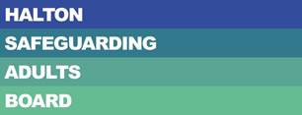
Halton Safeguarding Adults Board Annual Report April 2021 – March 2022

Slide 2
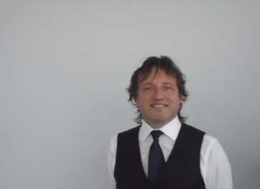
Message from the Chair
I am very pleased to present my third annual report at Chair of Halton Safeguarding Adult Board for 2021/22. The report is an opportunity to share the work of the Board more widely and it provides an overview of the progress and achievements made during this 12 month period which I hope you will find informative and useful.
During this Board year we have worked closely with partner agencies to ensure that safeguarding adults remained at the top of our agendas. We remain committed to ensuring that safeguarding is “Everyone’s Business” across Halton.
The context of our work over the next year will be to further strengthen our commitment in achieving the statutory functions of the Board, as well as focusing on our local priorities through the work of the Board and its sub groups.
Finally I would like to pay tribute to all those who have worked hard to support the Board and their continued commitment and focus on safeguarding
Adults in Halton. It has been another challenging year in light of the continuing impact of the pandemic on both our daily working and personal lives. However, I am confident that by working together, we can continue to improve the lives and outcomes of many of our vulnerable residents.
I look forward to working with you all again this year.
Milorad Vasic
Strategic Director, People Directorate Halton Borough Council

Slide 3
Key Safeguarding Facts 2021-22
1220 Safeguarding Concerns raised during the year
366 became S42 enquiries
More women than men were alleged victims
18-64 65-84 85+ 84 89 258
The age groups of people who had Concluded S42 enquiries Concluded S42 enquiries involved Concluded S42 enquiry allegations
safeguarding concerns raised on their behalf involved allegations of neglect allegations of physical abuse occurred in victim’s own home
736 White British
13 Black & Minority Ethnic
Ethnicity of those who had safeguarding concerns
raised on their behalf
10% Increase in the number of concerns raised, up from 1098 last year
8% Increase in the number which progressed to S42 enquiries, up from 336 last year
62%
38%
364
326
197
In Halton, an adult at risk is most likely to be a female aged 65 or over living in their own home and will suffer from neglect or acts of omission perpetrated by a service provider

Slide 4
Deprivation of Liberty Safeguards
847 applications received
32% increase in the number of DoLS applications received last year, up from 569 in 2020/21
517 applications received for females
330 applications received for males
291
288
139
115
Applications for 18-64 age group
Applications for 65-74 age group
Applications for 75-84 age group
Applications for 85+ age group

Slide 5
Overview of the Board
What is Halton Safeguarding Adults Board?
Halton Safeguarding Adults Board (HSAB) is a statutory partnership between the Local Authority, Cheshire Police, NHS, Fire Service and other organisations who work with adults with care and support needs in our Borough.
The role of the Board is to make sure that there are arrangements in Halton that work well to help protect adults with care and support needs from abuse and neglect.
The Board and its Duties
What is our vision?
Halton Safeguarding Adults Board strives to show improvement in fulfilling its statutory duties and a dedication to seeking and providing the best possible care and support to protect those members or our community that need it.
What does Safeguarding Adults mean?
Safeguarding adults means stopping or preventing abuse or neglect of adults with care and support needs.
Adults with care and support needs are aged 18 and over and may:
Have a learning disability
Have a mental health need or dementia disorder
Have a long or short term illness
Have an addiction to a substance or alcohol
And/or are elderly or frail due to ill health, disability or a mental illness
“Our vision is that people with care and support needs in Halton are able to live their lives free from abuse and harm”
Halton Safeguarding Adults Board
Safeguarding Adults Board were established under the Care Act 2014
Main SAB Objective | To assure itself that local safeguarding arrangements and partners act to help and protect adults in its area who meet the safeguarding adult criteria
3 Core Duties | 1. Publish an Annual Report
 | 2. Publish a Strategic Plan
 | 3. Conduct Safeguarding Adult Reviews

Slide 6
Overview of the Board
Halton Safeguarding Adults Board Structure

Slide 7
Overview of the Board
Who are HSAB’s partner organisations?

Slide 8
Priorities for 2021-22
Quality Assurance | Ensuring internal quality assurance frameworks are in place Ensuring any identified learning is shared Review of the safeguarding adults audit processes within Halton Sharing of information across HSAB members and provider services
Co-production & Engagement | Ensuring HSAB partner agencies have learning and professional development opportunities in place for their individual workforce Ensure there is a consistency and standardisation of safeguarding practice across Halton
 | Ensure all agencies promote a Making Safeguarding Personal approach Ensure that there is effective communication of training
Learning & Professional development | Reassurance that safeguarding approaches are developed actively including representation from all key areas Ensure that the voice of people who use services are heard, are involved in developing policy and are at the centre of any health and social care intervention ensuring their rights, wishes and feelings are at the heart of the decision making process

Slide 9
HSAB Achievements 2021/22
Priority | What we said we’d do | What we did
Quality Assurance | Ensuring internal quality assurance frameworks are in place | Following a restructure of HSAB last year, the Board now has a clear reporting structure in place which ensures that work programmes are closely monitored and any issues are identified and resolved quickly.
 | Share identified learning | The Safeguarding Practice Sub Group ensures that any lessons learned or areas of good practice are shared and adopted where possible.
 | Review of the safeguarding adults audit processes within Halton | The Safeguarding Adult Case File Audit policy was reviewed and updated, with the new process to go live from July 2022.
 | Sharing of information across HSAB members and provider services | The Chairs of each sub group are asked to share information within their groups on a regular basis, with quarterly reports presented to the Board.

Slide 10
HSAB Achievements 2021/22
Priority | What we said we’d do | What we did
Co Production & Engagement | HSAB partner agencies to have learning and professional development opportunities in place for their individual workforce | An annual training programme is developed and delivered on behalf of the board, which is available to all partner agencies.
 | Consistency and standardisation of safeguarding practice across Halton | All HSAB partner agencies approved the Halton Safeguarding Policy and Procedure documents which were reviewed and updated in 2020.
 | All agencies to promote a Making Safeguarding Personal approach | Making Safeguarding Personal is at the centre of all safeguarding practice in Halton, with a survey completed at the end of each S42 enquiry.

Slide 11
HSAB Achievements 2021/22
Priority | What we said we’d do | What we did
Co Production & Engagement | Implement effective communication of training opportunities within HSAB members and partner agencies | An annual training programme is developed and delivered on behalf of the board, which is available to all partner agencies.
 | Support the development of good multi-agency practice, sharing best practice, lessons learned and have the confidence to challenge decision making | The Safeguarding Practice Sub Group ensures that any lessons learned or areas of good practice are shared and adopted where possible. HSAB Partnership Forum have developed a Communications & Engagement Strategy for 2022-24 and action plan for delivery with partners.
 | Support adults at risk, informal carers and families with safeguarding and ensuring that they feel support within the safeguarding process | By adopting the Making Safeguarding Personal approach to safeguarding practice in Halton, to ensures the adult at risk is at the centre of all decisions and are supported to ensure their desired outcomes are met. HSAB Partnership Forum have led on the compilation, distribution and evaluation of an adult safeguarding awareness questionnaire/survey to support engagement with service users, family members/carers and the public regarding feedback on safeguarding services, to help shape services in the future.

Slide 12
HSAB Achievements 2021/22
Priority | What we said we’d do | What we did
Learning & Professional Development | Reassurances that safeguarding approaches are developed actively including representation from all key areas | Development of New Safeguarding Casefile Audit process shared and tested with practitioners and managers including the Partnership Forum members in advance of implementation. Partner representatives also invited to participate in multi agency audits from July 2022. New process includes reflection and sharing for all practitioners . It also includes any topics for learning and professional development reported to the SAB Practice group and SAB Executive Group.
 | Ensure that the voice of people who use services are heard, are involved in developing policy and are at the centre of any health and social care intervention ensuring their rights, wishes and feelings are at the hear of the decision making process | Engagement survey /questionnaire created for distribution in September 2022 through the SAB Partnership Forum for people who use services linked to safeguarding. Feedback will further support development of policy /communications and HSAB website.

Slide 13
Partner Achievements 2021/22
Cheshire Police
The VPA audit has been underway for a while and the report will be complete early May. The force adopted a new app to assist officers in completing VPAs which should improve the quality and encourages a more user friendly system. There is a new learning board being established within force which will take learning from SAR/DHRs. We are part way through the introduction to a new Public Protection Directorate structure. Child protection has returned to sit under the CP Detective Inspector who will also have supervision of Hidden Harm teams. The Hidden Harm teams will be made up of a DS and several DC’s who will target modern slavery. Missing from Home, Child Exploitation and High Risk Domestic Abuse. Halton now has its own Safeguarding DI. Previously DI Jo’anne Flanagan was the safeguarding DI for the whole of the north, including Halton and Warrington. As from February 2022, DI Deborah Morgan has taken up her post at the Halton Safeguarding DI which will provide consistency across Halton. | By way of year on year performance please see the summary below: Runcorn All Crime: This year April 2021-22 has seen a year on year increase of 5.8% in recorded crime. Solved rates have reduced by -1% with a solved rate in 2021/22 of 11.3%. There has been a steady year on year decline in solved crime rates since 2019, where the solved rate was 15.4%. Widnes All Crime: This year April 2021-22 has seen a year on year decrease of 3.3% in recorded crime. Solved rates have reduced by 1.1% with a solved rate of 11.5%. There has been a small decline in solved rates since 2019, where the solved rate was 12.8%

Slide 14
Partner Achievements 2021/22
Cheshire Police continued:
In comparison with another local police unit (LPU) and for reasons of demographic similarities, Ellesmere Port was chosen. Here crime recording has increased by 6.8% and solved rates have increased by 0.5% to 13.2%. When comparing the above to Cheshire as a whole, in April 2021/22, crime recording has increased by 7.4% with solved rates declining by 0.2% to 11.3%, Widnes does not follow the Cheshire trend and has a reduction of crime recording in 2021/22 which is unexplained. Crime Breakdown for Halton Violence against the person in Runcorn is up 3% but down 2% in Widnes. Violence with injury follows a similar trend. Crimes of stalking are up 1% in Runcorn and down 4% in Widnes, Hate Crimes are up 1% in Runcorn and up 5% in Widnes, equating to an addition 8 hate crimes. Crimes of domestic abuse are down by 9% in Runcorn and down 4% in Widnes. As a force the domestic abuse crimes are down by 2.6% ad looking at Ellesmere Port as a comparison which is down by 4.2%, Halton is following this trend. Domestic violence with injury tells a | similar story with Runcorn recording 9% less crimes and Widnes 1% less. Positively, there has been a slight increase in the solved rate for domestic abuse with and without violence. Runcorn has seen a reduction of 471 in the number of VPA’s submitted which may be a reflection in the reduction seen in recorded domestic abuse crimes, however, the high DASH gradings have increased year on year from 6.4% to 13.5%. Widnes has seen a similar increase of high DASH gradings from 9.2% to 12%. This may be attributed to the positive drive around domestic abuse instigated by our Chief Constable who was appointed in April 2021. There is a lot of work ongoing to raise awareness of safeguarding and an expectation that positive action will be taken at all domestic incidents, particularly arrests when it is right to do so. Widnes has seen an increase in the number of vulnerable adult VPA’s from 778 to 914 in 2021/22 This is an increase of 136. Runcorn as also seen a slight increase of 76.

Slide 15
Partner Achievements 2021/22
NHS Halton Clinical Commissioning Group
Quality Assurance NHS Halton Clinical Commissioning Group (HCCG) has reviewed and updated the contractual framework for safeguarding assurance that is required from all commissioned healthcare providers that deliver services within Halton. The assurance framework includes quarterly reporting on a range of safeguarding performance both quantitative and qualitative. NHS HCCG leads the delivery on all LeDeR reviews and workstreams across Halton and ensures local, regional and national learning is shared and actioned as required. NHS HCCG has implemented the inclusion of safeguarding indicators into the quality dashboard for Primary Care. This requires all practices to report and evidence engagement with the safeguarding adult’s agenda. NHS HCCG has implemented an audit with all GP practices for assurance that the Mental Capacity Act 2005 is being followed in respect of Covid vaccinations for patients with a learning disability. | NHS HCCG leads on the delivery of the Host Commissioner framework for independent Learning Disability/Autism hospital provider within the Borough. This enables regular quality and safeguarding oversight and management including assurance that the NHSE/I Safe and Well Reviews were completed and learning shared. Co-Production & Engagement NHS HCCG has commissioned the development of a film for people with a learning disability that explains about LeDeR, health inequalities and the importance of looking after your health. The Local Area contact for LeDeR actively contributes to the Cheshire and Merseyside LeDeR Steering Group which is co-produced with carers and has service user representatives. NHS HCCG actively supported National Safeguarding Adults Week through a range of awareness raising briefs to staff and communication cascades through social media.

Slide 16
Partner Achievements 2021/22
NHS Halton Clinical Commissioning Group continued:
Learning & Professional Development NHS HCCG lead a safeguarding forum/operational group for all safeguarding leads within health provider organisations. This group incorporates shared learning and development as part of every agenda. This has included topics such as Asylum and Refugees, fabricated and induced illnesses, non-accidental injury. NHS HCCG provide active engagement with the HSAB Practice sub-group and have led the developed of the PIPOT audit and active learning from SARs. NHS HCCG have shared local learning in respect of asylum seekers and safeguarding across the Cheshire & Merseyside designated network and co-produced a presentation to HSAB. NHS CCG provide quarterly learning and development to GP safeguarding leads, this has included Prevent, Channel and Neglect. Organisational Activity During the pandemic period HCCG led a regular multi-agency system assurance call. This enabled system partners to: | Keep connected Share assurance and updates on the current situation in respect of safeguarding Enable consistent communication and key messages re: safeguarding Share any emerging concerns/pressures and enable us to work together to mitigate where possible

Slide 17
Partner Achievements 2021/22
Bridgewater Community Healthcare Foundation Trust
Quality Assurance Robust governance arrangements are in place to assure quality these include: Internal Assurance – The Safeguarding Trust Assurance Group (STAG) provides a forum for safeguarding leads and all members to work together to receive assurance, address and discuss safeguarding issues within the community setting and delivers assurance to the Quality Council and the Quality & Safety Committee within the Trust. External Assurance – Safeguarding assurance is provided to our Commissioners in Halton and Warrington. This is achieved through detailed and comprehensive quarterly submissions of evidence to support the quality schedule as well as annual completion of safeguarding audit tools which evidence our compliance with the NHS Safeguarding Accountability and Assurance Framework 2015. Co-Production & Engagement Bridgewater has been actively engaged with the joint Halton and Warrington Health Executive and Operational Sub Groups to help support the input from health provider organisations into the SAB. We note limited SAB activity with provider organisations during 2021-22, there has been engagement with the Safeguarding Practice Group following its inception in October 2021 and look forward to the opportunities the group may present for multi-agency audit going forward. | Bridgewater has continued to develop its relationships with Halton Integrated Adult Safeguarding Unit to enable discussion and proportionate information sharing related to safeguarding concerns. Bridgewater actively supports national safeguarding campaigns though both internal communications and the safeguarding social media account. As an example World Elder Abuse Awareness Day takes place every year on the 15th June. The Safeguarding Adult Team sought to mark this with a message of “Ask, Question, Act”: Ask: Do you feel safe? A simple question asked of the people we are caring for may just be the trigger for the person to be able to talk about their concerns Question: Be ‘professionally curious’ Try to explore and understand what is happening within a family rather than making assumptions or accepting things at face value Act: Act to support the person Seek advice and support from the Safeguarding Adult Team, make a safeguarding referral to the local authority. Do not ignore abuse Following a strong message from the Chief Nurse in the Trust Bulletin, this message went out across the Trust on the desktop of all computers alongside a 7 minute briefing focused on domestic abuse in older adults and promotion via social media.

Slide 18
Partner Achievements 2021/22
Bridgewater Community Healthcare Foundation Trust continued:
Learning & Professional Development Alongside mandatory training in Safeguarding Adults, PREVENT and the Mental Capacity Act, the Trust has had a programme of campaigns and briefings to keep safeguarding adults in the spotlight Organisational Activity The Trust’s Learning Disability Improvement Group was re-established with attendance by the Safeguarding Adult Lead and dedicated specialist support of one day a week to the groups work plan from the Specialist Safeguarding Nurse. The Safeguarding Adult Lead represents the Trust at the multi-agency Learning Disability Standards Group, chaired by the Deputy Chief Nurse, Warrington & Halton CCG. A guideline supporting working with people with LD was developed and is being launched at the start of 2022-2023.

Slide 19
Partner Achievements 2021/22
Warrington & Halton Hospital Foundation Trust
Quality Assurance Warrington and Halton Teaching Hospitals Foundation Trust (WHHFT) continue to support the HSAB agenda. WHHFT takes its safeguarding responsibilities seriously and will continue to monitor training, incidents and promote multi-agency learning. Assurance is provided via Safeguarding Committee to the Trust Quality Assurance Committee regarding the progress of training trajectories, incident action plans and strategy work plans, this reporting structure ensures robust scrutiny and challenge of WHHFT safeguarding duties and responsibilities. Co-Production & Engagement Domestic Abuse – A review of the role of the Hospital Independent Domestic Violence Advocate (IDVA) resulted in a Hospital IDVA now based with the safeguarding adult and children’s team. The post concentrates on supporting the safeguarding team and wider ward/department teams with the domestic abuse referrals and providing support to patient and staff victims. Self-Neglect – The Trust Safeguarding Adult’s Policy contains guidance on how to support patients who self-neglect and directs staff to where they can find held and assistance. Work has happened via supervisory sessions to ensure staff in A&E are alerted to the safeguarding | challenges related to patients who self-neglect. Learning Disability – Warrington and Halton Teaching Hospitals LD/Autism Steering Group has been launched. The action plan and strategy are linked to the LD National Improvement Standards audit. Improvement actions have included: Reasonable adjustment care plan and Standard Operating Procedure (SOP) developed Makaton Monday, staff receive training every Monday via a trust wide teams briefing so that they can be taught basic Makaton signing to assist them in communicating with patients who require this A WHH LD passport has been developed to be used when patients do not have one or have not brought theirs with them Flagging system that sends alerts to specific staff when patients with LD are admitted to hospital, there are twice daily welfare checks from matrons and lead nurses and daily welfare checks from the adult safeguarding team that ensure patients and their families are supported

Slide 20
Partner Achievements 2021/22
Warrington & Halton Hospital Foundation Trust continued:
Learning & Professional Development WHHFT is committed to delivering a high quality inter-agency training programme, which supports professionals and volunteers in their work to safeguard and promote the welfare of adults, children and young people. All professionals and their teams have access to and engage in training commensurate to their role and level of responsibility. The safeguarding training programme was interrupted slightly during COVID due to the social distancing measures, however this was addressed by moving away from socially distanced rooms to Microsoft Teams delivery to aid compliance. LD and Autism mandatory training program delivered daily to all staff of all grades at a level suited to their role. Adult Level 3 training includes modern slavery/trafficking case study workshops.

Slide 21
Partner Achievements 2021/22
Elysium – Gateway Recovery Centre
Quality Assurance Gateway Recovery Centre have introduced a new substantial role of Safeguarding Lead/Coordinator. This role involves one individual overseeing the entire process, one point of contact and coordination with multi-agencies. Annual safeguarding assurance tool audit completed and action plan created and reviewed monthly during clinical governance meetings. Actions from safeguarding enquiries are reviewed monthly during Senior Management Team meetings and clinical governance to ensure actions are completed and consistent across the hospital. Co-Production & Engagement Making Safeguarding Personal, including the views of patients is threaded throughout all safeguarding enquiries. Weekly meetings held with Gateway Recovery Centre and Halton Borough Council to review safeguarding concerns and open enquiries and seeks assurances that actions have taken place to minimise risks. A collaborative approach toward decision making is followed with a view to provide the best possible outcome for the patient. | Monthly multi-agency meetings held on the first Wednesday of each month including Halton Borough Council, HCCG, Gateway Recovery Centre leads and ward managers, police liaison and advocates. Gateway Recovery Centre has a good working relationship with advocacy (Healthwatch Halton) – sharing concerns and updates discussed in the safeguarding weekly meeting. Learning & Professional Development Lessons learnt from enquiries are shared across the hospital and local/regional governance. Gateway Recovery Centre deliver mandatory training to all staff including Safeguarding Adults and Children at level 3, DOLs, MCA, MHA, MVA, Medication Management. All staff have supervision at least monthly which includes reviewing safeguarding concerns and identifying training needs. Gateway Recovery Centre identify staff who would benefit from training offered by Halton Borough Council and actively take part in multi-agency/regional training opportunities.

Slide 22
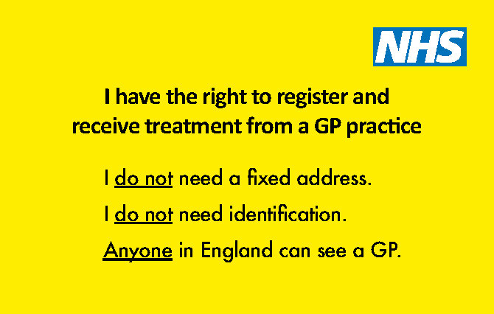
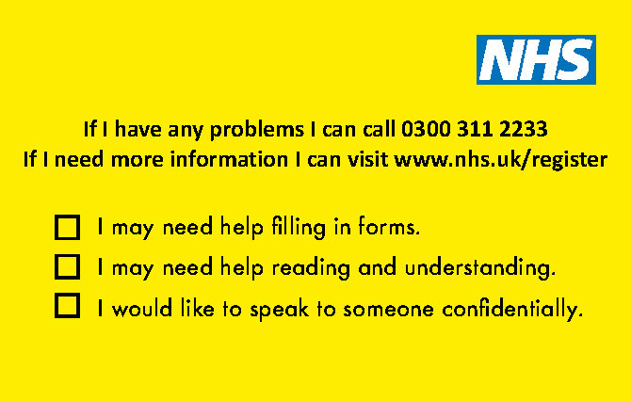
Partner Achievements 2021/22
Healthwatch Halton
During the pandemic opportunities to meet and engage with the public face to face were limited so we needed to ensure we continued to provide the public with information that was accessible and up to date. Our website and social media channels were updated regularly with the latest information on the pandemic, vaccination programmes and health and social care service updates. We joined in with many local Healthwatch across the country to highlight the issues faced by the homeless in accessing/registering with a GP. Working with NHS England and Healthwatch England, we distributed more than 100 GP ‘access cards’ to organisations across the borough. | During National Safeguarding Adults Awareness Week in November 2021, we visited Runcorn Shopping City and distributed posters promoting safeguarding to the stores within the centre. A number of posters were also displayed in Halton Lea Library. When we’ve had the opportunity to hold outreach sessions in the community this year, we have continued to raise awareness of the role the public can play in safeguarding. This included our outreach session to the Heath Business Park where we requested that staff promote safeguarding on the many noticeboards throughout their offices, we also handed out safeguarding information cards to more than 200 attendees at the ‘Eat at the Heath’ and Coffee and Cake group events. In addition, we have joined in with the Public Health Team on the community bus at venues around the borough, during which we have given out safeguarding information to Halton residents.

Slide 23
Partner Achievements 2021/22
Healthwatch Halton continued:
Healthwatch Halton Advocacy Hub During the past year Healthwatch Halton’s Advocacy Hub has supported more than 150 IMHA patients at the Gateway Recovery Centre and the Brooker Centre. The team support ongoing autistic and patients with learning difficulties, primarily each week and support extra meetings and assessments for these patients. The Healthwatch Halton advocacy team responded to approximately 45 seclusion/safeguarding issues across the statutory services. The main response for safeguarding is via Care Act referrals but we have also supported safeguarding concerns within the hospitals and work closely with the safeguarding team in ensuring standards at Gateway Recovery Centre and with Mersey Care NHS for the Brooker Centre. The advocacy team has been instrumental in identifying and reporting sub standards observed in the Women’s Ward at the Brooker Centre. Improvements have since been implemented and now there is an assigned Matron covering both the male and female wards. The team have supported 71 IMCA referrals, primarily serious medical | treatment decisions and this increased significantly throughout the Covid period. We have supported 76 DoLS referrals and continue to act as the Relevant Person’s Representative (RPR) for over 50 current cases. We have supported 45 Care Act referrals, with safeguarding remaining the main area of referrals within this statutory provision. We are also supporting clients now with community DoLS in place and also acting as a Litigation Friend to enable challenges to go through the Court of Protection in a more timely manner.

Slide 24
Partner Achievements 2021/22
Probation Service
Quality Assurance The last 12 months has been a period of significant change for the probation service, moving from two organisations (National Probation Service and Community Rehabilitation Company) to a unified service. Since June 2021, we are now a unified probation service and we have been imbedding new practices/processes across the organisation. We remain actively involved in the safeguarding partnership and have supported quality assurance activities. Internally, we are imbedding a new Quality Assurance framework which provides us with indepth oversight of practices. This is in its early days but we will eventually be able to share QA information with the partnership in relation to adult safeguarding specifically in relation to domestic abuse, vulnerable adults and violent/sexual offenders. Co-Production & Engagement As part of the probation service unification, we are imbedding a new approach to service user engagement and co-production. We have a dedicated engaging people on probation lead and are in the process of imbedding with within the Halton team. This role will seek to engage person on probation (POPs) to develop insight into our delivery model and also explore the options of co-production. Our delivery model is based on co-produced agreed action plans as basis for encouraging and motivating long term change | Learning & Professional Development We continue to have a nationally prescribed training package for Probation staff which remains a priority in terms of continued professional development. We also encourage and enable engagement in local training events via the partnership.

Slide 25
Partner Achievements 2021/22
Age UK Mid Mersey
Quality Assurance Age UK Mid Mersey have achieved the Charity Quality Standards. Safeguarding is fundamental element of the framework with robust assessment measures in place to continually assess performance. A full assessment was conducted in August 2021 with re-certification of having full met the standards – valid until January 2023. Our Wellbeing Team participate in a monthly case file review process that enables us to review any safeguarding alerts, promote learning and improve practice. The safeguarding risks of all new activities and services provided by the organisation are identified, assessed and addressed to ensure that there is nothing identified that will have an impact on our safeguarding provision. As a result of a recent review it was identified that a larger group of staff now require DBS checks at an enhanced level, which have subsequently been obtained. The organisation has reviewed any complaints/incidents to identify any underlying safeguarding issues. The organisation also have representation at the partnership forum and attendance at various stakeholder meetings which allows for efficient | sharing of information. Co-Production & Engagement The CEO is a member of the HSAB and our Charitable Services Director is also a member of the HSAB Partnership Forum and as a result the organisation fully collaborates with a wide range of stakeholders and key safeguarding teams across the local authority. We work together with key partners and organisations in a multidisciplinary approach to support older adults to make decisions about safeguarding risks affecting them. Safeguarding is recognised at the highest possible level of involvement in the organisation as sits at the core of strategic planning and development. Learning & Professional Development All Age UK Mid Mersey staff undertake annual online training via a platform with Grey Matters Learning in subjects like Safeguarding Adults, Mental Capacity Act Essentials, Mental Health, Dementia and Learning Disabilities Essential, Person-Centred Care. This ensures our staff are better equipped and aware of key responsibilities in the borough and how to use and communicate them.

Slide 26
Partner Achievements 2021/22
Age UK Mid Mersey continued:
As outlined above, our Wellbeing Team participate in a monthly case file review process that enables us to review any safeguarding alerts, promote learning and improve practice. This has ensured that staff confidently identify safeguarding concerns and refer in a timely manner. Organisational Activity Age UK Mid Mersey have rolled out a new Wellbeing Model, delivering a holistic wellbeing service. Age UK Mid Mersey are using a new process for all enquiries, with a single point of access to ensure all enquiries can be tracked and monitored. There is a client profile screening tool which is completed with all incoming referrals. A key section of this screening tool asks questions around health, living conditions, isolation and loneliness and highlights at risk clients to allow staff to escalate any safeguarding concerns promptly. Age UK have created a partnership with the Office of the Police & Crime Commissioner Cheshire to raise awareness and safeguard vulnerable older adults in relation to online scams. We have initiated a unique research programme called Utopiage as an extension to our Do you See Me campaign. We believe that challenging the cultural attitudes towards ageing and older people will encourage | society to change their perspective about older people so that they are seen as more than just their age and more people will feel empowered to discuss safeguarding concerns. We have launched a number of successful social groups across Halton to encourage older people to connect. These groups prove excellent forums to capture local views and raise awareness of key issues.

Slide 27
HSAB Strategic Planning Event
HSAB held a virtual Strategic Planning Event on Monday 2nd August 2021 via MS Teams, to develop priorities and key actions to inform the “Strategic Plan on a Page” and work programmes of the HSAB and its associated sub groups. The event was well attended with 30 representatives from all statutory partners, health sector and voluntary/third sector organisations as detailed below:

Slide 28
HSAB Strategic Planning Event
The event was facilitated by Claire Bruin, Care and Improvement Advisor of England for the Local Government Association. The event began with an introduction and outline of the event that Claire presented, reminding partners of the legal context from the Care Act 2014, along with collective and individual responsibilities.
Helen Moir, Divisional Manager for Independent Living and Safeguarding Lead for Halton Borough Council, gave a presentation on the pre-work themes and what the data is telling us.
This lead to five breakout room discussions focused on the draft Strategic Plan; what other work areas should be added to the draft plan; what actions can organisations take to progress the proposed work areas and what support or guidance might sub groups provide to support member organisations. Each group had a one hour discussion and then fed back to the whole group. From this multi-agency engagement event a “Strategic Plan on a Page” has been formulated, based on the three main HSAB priorities of Quality Assurance; Learning & Professional Development and Co-production & Engagement.
Next Steps
Information gathered from the Strategic Planning event will be used by HSAB sub group Chairpersons to support the development of the work programmes for the sub-groups into 2021/22 and beyond. Progress
with the work programmes will be monitored through the HSAB Executive Group, who will update HSAB as appropriate.
Due to the success of the Strategic Planning Event and the momentum achieved with engagement across the partner agencies, future planning sessions will be arranged.

Slide 29
National Safeguarding Week
HSAB supports the National Safeguarding Adults Week on an annual basis, it took place this year during 15th – 21st November 2021. The campaign came about through a national collaboration with Ann Craft Trust and the Safeguarding Adults Board Managers Network, supported by University of Nottingham. Locally, HSAB collaborated with the following statutory, private and voluntary services to help raise awareness of National Safeguarding Week across Halton:
The aim of the campaign this year was “To create safer cultures”. Each day during National Safeguarding Week focuses on a key theme, the daily themes for this year were as follows
Day | Theme
Monday | Emotional Abuse and Safeguarding Mental Health
Tuesday | The Power of Language
Wednesday | Digital Safeguarding
Thursday | Adult Grooming
Friday | Creating Safer Organisational Cultures
Saturday & Sunday | Safeguarding and You

Slide 30
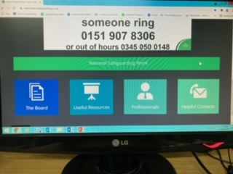
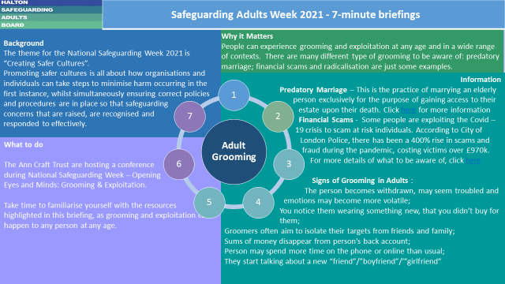
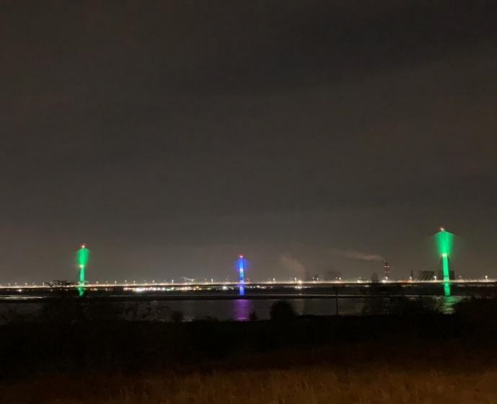
National Safeguarding Week
The campaign consisted of:
A 7 minute briefing for each daily theme
HSAB Website fully updated and now has a dedicated National Safeguarding Week tab with all information easily accessible
Articles written for various newsletters
and local press
Mersey Gateway Bridge lit up in
HSAB colours to mark the start of
National Safeguarding Week
Daily social media messages published
on all HBC Social Media Platforms

Slide 31
Asylum Seekers & Refugees in Halton
Whilst asylum seekers are largely NOT the sole responsibility of the Council, the impact of this group within our communities shouldn’t be underestimated, nor the impact on services and partners depending on legislation and need
Generally speaking they are in a category called No Recourse to Pubic Funds (NRPF has a very specific meaning. It means no recourse to local authority housing, homelessness services and means tested welfare benefits)
They can’t work, claim benefits or attend higher education. There are some exceptions – always check. They are entitled to register with a GP and get primary and secondary care, maternity and emergency care. Some education entitlement after 6 months
All children of school age – no matter what their’s or their par currently free school meals
Government expects gaps to be filled by third sector, yet provides very little funding and support
No additional resources come to a local authority for asylum seekers
People seeking asylum get £37.75 a week
Serco manage the temporary accommodation used by asylum seekers in Halton during the entire application process. This is divided between the first few weeks in an Initial Accommodation Centre then moving into dispersed accommodation
Dispersed accommodation in Halton we have 134 properties with approximately 585 people. These are mainly single young males, which reflects the overall asylum population. There are some families and some single females, with one mother and baby property
Serco is required as part of their contract, to consult with Local Authorities on the procurement of dispersed accommodation. The council has no involvement in the placement of asylum seekers or the procurement of property
Ukraine Refugees
People from Ukraine need a visa to enter the UK, unlike the rest of Europe – there are currently no plans to change this
There are two visa routes identified to support Ukranian

Slide 32
Asylum Seekers & Refugees in Halton
nationals who want to come to the UK – the Ukranian Family Scheme and Homes for Ukraine (community sponsorship)
Eligibility for, and approval of, visas is the responsibility of the Home Office, but the Homes for Ukraine scheme is being administered by the Department for Levelling Up, Housing and Communities (DLUHC)
There is no cap on the number of visas that can be issued under either scheme – they will be demand-led
There is no proposal to apportion people applying to a particular area/region – where people move to will depend on where they have family or sponsors depending on the scheme they enter the UK under
Ukrainian Family Scheme
Very little local authority involvement – as it’s family to family
They don’t have to notify that family have received visas and arrived
In Halton we currently know of 2 families as we have asked
schools to notify us of any requests for places
Homes for Ukraine (Community Sponsorship)
People have to match with a Ukrainian themselves and complete a visa application on their behalf
Local authority will be notified and then has to do safeguarding and accommodation checks
DBS on any adult in the sponsor’s household and an Enhanced DBS if there are children or a vulnerable adult involved
There is funding available to the local authority to facilitate wrap around support required
Sponsors receive a monthly £350 thank you from the Government for up to 12 months
Any Ukraine refugee coming to Halton under either scheme will be offered the support of the Refugee Resettlement Team

Slide 33
LeDeR Update
The Learning from Life & Death Reviews (LeDeR) programme is part of a national focus upon improving the lives and care of people with Learning Disabilities and Austistic people. It has derived as an outcome from a series of national reports that describe that whilst care in many instances has improved over the last decade, many aspects have not. There are still marked health inequalities for people with learning disabilities and autism, compared to that of the general population.
Since 2019, NHS Halton Clinical Commissioning Group (HCCG) and NHS Warrington Clinical Commissioning Group (WCCG) agreed to take a combined approach to delivery of a national LeDeR programme, through the establishment of a LeDeR panel, shared Local Area Contact and agreed governance frameworks to capture local learning.
A national LeDeR policy was developed for the first time in March 2021. This brings significant changes to the LeDeR programme including transition to an Integrated Care Board LeDeR team, the inclusion of autism within the scope for LeDeR reviews and a stronger emphasis on the delivery of the thematic actions coming out of the reviews.
In Cheshire and Merseyside, the priorities for 2021-2022 were agreed by the Cheshire and Merseyside LeDeR Strategy Steering Group as follows:
Management of medical conditions
Vaccination Programme (including seasonal flu and COVID vaccinations
Managing deterioration of health
Changing how we work
Developing the LeDeR processes and implementation of the new LeDeR policy, including governance arrangements
Intergrating care between community and acute settings
DNACPR
Annual Health Checks (AHCs) uptake
For 2020/21 the two highest causes of death for Halton from the LeDeR reviews was aspiration pneumonia and pneumonia. Halton achieved an uptake rate for Covid vaccines in people

Slide 34
LeDeR Update continued
with a Learning Disability of 92.80% for the first vaccine. AHCs in Halton achieved 82.66%.
To raise awareness of LeDeR HCCG/WCCG worked with Warrington Speak Up Advocacy Service to commission a video co-produced with people with a learning disability. The video talks about LeDeR and the importance of looking after your health and engaging with health services.
From 1st July 2022, Cheshire and Merseyside ICB will host a dedicated reviewer LeDeR workforce, a combined reviewer team with Greater Manchester. The dedicated team will be led by a Senior Reviewer and will be supported by a LeDeR administrator. A Local Area Contact will also be in place for Cheshire and Merseyside who will be independent and separate to the Review team.
Leadership of the LeDeR programme will transfer to the ICB from July 2022, but will continue to be supported by good local engagement and the strong partnerships that have been established through the local LeDeR delivery.

