Slide 1

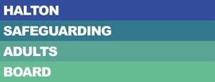
Halton Safeguarding Adults Board Annual Report April 2022 – March 2023

Slide 2
Contents Page
Section | Page Number
Message from the Chair | 3
Key Safeguarding Facts 2022/23 | 4
Deprivation of Liberty Safeguards | 5
Priorities for 2022/23 | 6
HSAB Achievements 2022/23 | 10
Partner Achievements | 14
Policy, Procedure & Practice Sub Group Update | 34
Safeguarding Adult Review Sub Group Update | 35
Performance, Quality Assurance & Audit Sub Group Update | 36
Section | Page Number
Partnership Forum Update | 37
HSAB Strategic Planning Event | 38
National Safeguarding Week | 40
Scam Awareness Events | 42
Multi-Agency Audits | 43
Modern Slavery Toolkit | 44
Financial Abuse Toolkit | 45
Case Study | 46

Slide 3
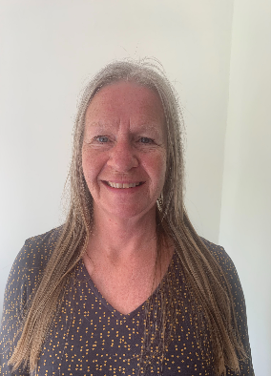
Message from the Chair
I am very pleased to present the annual report of Halton Safeguarding Adult Board for 2022/23. The report is an opportunity to share the work of the Board more widely and it provides an overview of the progress and achievements made during this 12 month period which I hope you will find informative and useful.
During this year we have continued to work closely with partner agencies to ensure that safeguarding adults remained at the top of our agendas. We remain committed to ensuring that safeguarding is “Everyone’s Business” across Halton.
The context of our work over the next year will be to continue to strengthen our commitment in achieving the statutory functions of the Board, as well as focusing on our local priorities through the work of the Board and its sub groups.
Finally I would like to extend my thanks to all those who continue to work hard to support the Board and their continued commitment and focus on safeguarding
Adults in Halton. By working together, we can continue to improve the lives and outcomes of many of our vulnerable residents.
I look forward to working with you all again this year.
Sue Wallace-Bonner
Executive Director, Adults Directorate Halton Borough Council

Slide 4





Key Safeguarding Facts 2022-23
1096 Safeguarding Concerns raised during the year
436 became S42 enquiries
More women than men were alleged victims
18-64 65-84 85+ 227 105 218
The age groups of people who had Concluded S42 enquiries Concluded S42 enquiries involved Concluded S42 enquiry allegations
safeguarding concerns raised on their behalf involved allegations of neglect allegations of financial abuse occurred in victim’s own home
689 White British
21 Black & Minority Ethnic
Ethnicity of those who had safeguarding concerns
raised on their behalf
10% Decrease in the number of concerns raised, down from 1220 last year
19% Increase in the number which progressed to S42 enquiries, up from 366 last year
59%
41%
327
329
159
In Halton, an adult at risk is most likely to be a female aged 65 or over living in their own home and will suffer from neglect or acts of omission perpetrated by a service provider

Slide 5
Deprivation of Liberty Safeguards
(DoLS)
894 applications received
6% increase in the number of DoLS applications received last year, up from 847 in 2021/22
518 applications received for females
376 applications received for males
299
332
142
121
Applications for 18-64 age group
Applications for 65-74 age group
Applications for 75-84 age group
Applications for 85+ age group

Slide 6
Overview of the Board
What is Halton Safeguarding Adults Board?
Halton Safeguarding Adults Board (HSAB) is a statutory partnership between the Local Authority, Cheshire Police, NHS, Fire Service and other organisations who work with adults with care and support needs in our Borough.
The role of the Board is to make sure that there are arrangements in Halton that work well to help protect adults with care and support needs from abuse and neglect.
The Board and its Duties
What is our vision?
Halton Safeguarding Adults Board strives to show improvement in fulfilling its statutory duties and a dedication to seeking and providing the best possible care and support to protect those members or our community that need it.
What does Safeguarding Adults mean?
Safeguarding adults means stopping or preventing abuse or neglect of adults with care and support needs.
Adults with care and support needs are aged 18 and over and may:
Have a learning disability
Have a mental health need or dementia disorder
Have a long or short term illness
Have an addiction to a substance or alcohol
And/or are elderly or frail due to ill health, disability or a mental illness
“Our vision is that people with care and support needs in Halton are able to live their lives free from abuse and harm”
Halton Safeguarding Adults Board
Safeguarding Adults Board were established under the Care Act 2014
Main SAB Objective | To assure itself that local safeguarding arrangements and partners act to help and protect adults in its area who meet the safeguarding adult criteria
3 Core Duties | 1. Publish an Annual Report
 | 2. Publish a Strategic Plan
 | 3. Conduct Safeguarding Adult Reviews

Slide 7
Overview of the Board
Halton Safeguarding Adults Board Structure

Slide 8













Overview of the Board
Who are HSAB’s partner organisations?

Slide 9



Priorities for 2022-23
Quality Assurance | Ensuring internal quality assurance frameworks are in place Ensuring any identified learning is shared Review of the safeguarding adults audit processes within Halton Sharing of information across HSAB members and provider services
Co-production & Engagement | Ensuring HSAB partner agencies have learning and professional development opportunities in place for their individual workforce Ensure there is a consistency and standardisation of safeguarding practice across Halton
 | Ensure all agencies promote a Making Safeguarding Personal approach Ensure that there is effective communication of training
Learning & Professional development | Reassurance that safeguarding approaches are developed actively including representation from all key areas Ensure that the voice of people who use services are heard, are involved in developing policy and are at the centre of any health and social care intervention ensuring their rights, wishes and feelings are at the heart of the decision making process
9

Slide 10
HSAB Achievements 2022/23
Priority | What we said we’d do | What we did
Quality Assurance | Ensuring internal quality assurance frameworks are in place | Following a restructure of HSAB and its sub groups, the Board now has a clear reporting structure in place which ensures that work programmes are closely monitored and any issues are identified and resolved quickly.
 | Share identified learning | The Safeguarding Policy, Procedure & Practice Sub Group ensures that any lessons learned or areas of good practice are shared and adopted where possible.
 | Review of the safeguarding adults audit processes within Halton | The Safeguarding Adult Case File Audit policy was reviewed and updated in July 2022. There have been 2 multi-agency audits held during the year. The first audit focused on financial abuse and the second audit focused on self-neglect.
 | Sharing of information across HSAB members and provider services | The Chairs of each sub group are asked to share information within their groups on a regular basis, with quarterly reports presented to the Board.

Slide 11
HSAB Achievements 2022/23
Priority | What we said we’d do | What we did
Co Production & Engagement | HSAB partner agencies to have learning and professional development opportunities in place for their individual workforce | An annual training programme is developed and delivered on behalf of the board, which is available to all partner agencies.
 | Consistency and standardisation of safeguarding practice across Halton | All policy and procedure documents, toolkits and strategies developed in relation to adult safeguarding are agreed by HSAB and the relevant sub groups. All policies are reviewed on a 3 yearly basis ,, or earlier if required, to ensure they are reflective of current processes and legislation
 | All agencies to promote a Making Safeguarding Personal approach | Making Safeguarding Personal is at the centre of all safeguarding practice in Halton, with a survey completed at the end of each S42 enquiry.

Slide 12
HSAB Achievements 2022/23
Priority | What we said we’d do | What we did
Co Production & Engagement | Implement effective communication of training opportunities within HSAB members and partner agencies | An annual training programme is developed and delivered on behalf of the board, which is available to all partner agencies.
 | Support the development of good multi-agency practice, sharing best practice, lessons learned and have the confidence to challenge decision making | The Safeguarding Policy, Procedure & Practice Sub Group ensures that any lessons learned or areas of good practice are shared and adopted where possible. HSAB Partnership Forum have developed a Communications & Engagement Strategy for 2022-24 and action plan for delivery with partners.
 | Support adults at risk, informal carers and families with safeguarding and ensuring that they feel support within the safeguarding process | By adopting the Making Safeguarding Personal approach to safeguarding practice in Halton, to ensures the adult at risk is at the centre of all decisions and are supported to ensure their desired outcomes are met. HSAB Partnership Forum have led on the compilation, distribution and evaluation of an adult safeguarding awareness questionnaire/survey to support engagement with service users, family members/carers and the public regarding feedback on safeguarding services, to help shape services in the future.

Slide 13
HSAB Achievements 2022/23
Priority | What we said we’d do | What we did
Learning & Professional Development | Reassurances that safeguarding approaches are developed actively including representation from all key areas | Development of New Safeguarding Case File Audit process was shared and tested with practitioners and managers including the Partnership Forum members in advance of implementation in July 2022. Partner representatives also invited to participate in multi agency audits, with representatives from partner agencies given the opportunity to act as Lead Auditors.
 | Ensure that the voice of people who use services are heard, are involved in developing policy and are at the centre of any health and social care intervention ensuring their rights, wishes and feelings are at the hear of the decision making process | Engagement survey /questionnaire was created and distributed in September 2022 through the SAB Partnership Forum for people who use services linked to safeguarding. Feedback was used to inform the Communication & Engagement Strategy.

Slide 14
Partner Achievements 2022/23
Halton Borough Council
Halton Borough Council has continued to support the work of Halton Safeguarding adults Board and it’s sub groups this year. The Board and all of it’s sub groups include at least two members of Halton Borough staff on each group. The work that has been led by Halton Borough Council this year includes the planning and hosting of the HSAB Strategic Planning Event. This is an annual planning event that takes places every December and provides an opportunity for the Board members to contribute to priority setting for the Board and it’s sub groups for the forthcoming year. As part of the work of the Policy and Practice Sub Group, two scam awareness events were held over the summer in Widnes and Runcorn. Both events were a great success and well supported by our partner agencies. National Safeguarding Week was supported once again this year, with a series of Lunch & Learn events on various aspects of safeguarding hosted online. These events were all well attended and received | positive feedback. A new Safeguarding Adults Multi Agency Case File Audit Policy was implemented this year. Two multi agency audits took place during the year, with a total of 6 cases being reviewed and analysed. During the year, a Modern Slavery Toolkit was developed and published and the Financial Abuse Toolkit was updated and published. The Safeguarding Induction Booklet was also reviewed and updated. This booklet is designed to help new members of staff joining the Directorate to familiarise themselves with safeguarding and their role and responsibilities when dealing with any safeguarding concerns they may identify. A Supporting People with Dementia to be involved in Safeguarding Enquiries Toolkit was also developed and published this year. This toolkit is a useful resource for practitioners to use when involved in Section 42 Enquiries where the adult at risk or a family member has dementia.
14
14

Slide 15

Partner Achievements 2022/23
Cheshire & Merseyside Integrated Care Board
Quality Assurance NHS Cheshire & Merseyside Integrated Care Board (C&M ICB) Halton Place has received quarterly safeguarding assurance from NHS commissioned health providers. Safeguarding activity at local NHS providers shows an increased demand for support from NHS Safeguarding Teams. This demonstrates that staff are acting on concerns. NHS C&M ICB have devised and implemented a region wide safeguarding assurance framework, this will increase consistency in practice. The new framework will be used from Quarter 1 2023/24. A change to the LeDeR review process was implemented in 2022. LeDeR reviews are now completed by NHS C&M ICB dedicated LeDeR team. Learning will be shared with the Integrated Care System. NHS C&M ICB staff supported Primary Care colleagues in relation to Covid vaccination for people who lacked capacity to consent. Mental Capacity Act awareness training was facilitated with practice nurses. To support the health provision to Daresbury initial accommodation | centre, a maternity pathway was developed by Warrington and Halton NHS Foundation Trust, this is fully operational. Primary Care provision planned and urgent is available, including on site service. There is a pathway for onward referral to the 0-19 service. The emergency dental line is used for emergency issues and work is progressing around a planned service for residents. Co-Production & Engagement NHS C&M ICB and health providers have worked in partnership with other key partners to support Daresbury initial accommodation centre. Meetings are ongoing. NHS C&M ICB and health providers have worked collaboratively with Halton Borough Council safeguarding colleagues and the HSAB partnership on all sub group areas. This includes various task and finish groups, audit workstream and National Safeguarding Adults Week. In September 2022, NHS C&M ICB and health providers supported the Multi-Agency Audit around financial abuse. Further audits are planned for 2023/24.
15
15

Slide 16
Partner Achievements 2022/23
Cheshire & Merseyside Integrated Care Board continued:
Learning & Professional Development GP safeguarding leads meetings have continued this year. This involved cascading relevant safeguarding information (child and adult) to primary care. In addition, safeguarding information is relayed in regular primary care bulletins. NHS providers supported HSAB Safeguarding Adults Week Lunch and Learn events. Providers also attended events over the week. During 2022/23 NHS providers have continued to report challenges in delivering face to face training. Post covid factors, acuity levels and staff levels have all impacted on the ability to achieve full training compliance. These factors have led to an increased demand for specialist Trust safeguarding advice. Bridgewater Community Healthcare NHS Foundation Trust facilitated several supervision sessions with staff across Halton. Topics included Learning Disabilities Practice Guidelines and Self-Neglect. Warrington & Halton Hospitals Foundation Trust Team supported the World Down’s Syndrome Day with a week of celebrations across the trust. The Safeguarding Team complete daily checks on all patients | Admitted with a learning disability diagnosis. Organisational Activity On 1st July 2022 NHS Halton Clinical Commissioning Group transitioned to the Integrated Care System. Forming part of NHS C&M ICB at Halton Place. During this time of change business as usual has continued in all aspects of safeguarding practice. Safeguarding leads have been appointed within NHS C&M ICB ad they will commence in post in early 2023/24. NHS C&M ICB Health Providers worked throughout 2022/23 to improve MCA knowledge in preparation for the introduction of the Liberty Protection Safeguards (LPS). NHS C&M ICB and NHS providers responded to the Government’s draft LPS and MCA Code of Practice. Regular supportive meetings took place to aid all services around the anticipated implementation. Collaborative work has continued over the last 12 months in relation to health input to support Asylum Seekers.
16

Slide 17
Partner Achievements 2022/23
Cheshire & Merseyside Integrated Care Board continued:
Individual NHS providers have completed internal safeguarding audits over the 12 month period, to improve practice and give assurances. Safeguarding Named GP posts have now been recruited to. Halton will be allocated several weekly sessions. This will support primary care with safeguarding practice.
17

Slide 18
Partner Achievements 2022/23
Bridgewater Community Healthcare Foundation Trust
Quality Assurance: As part of the commissioning arrangements with NHS Cheshire and Merseyside, the Trust reports on a quarterly basis to provide assurance that Bridgewater Community Healthcare NHS Foundation Trust is fulfilling its responsibilities under: The Care Act 2014 The Health and Social Care Act 2008 (Regulated Activities) Regulations 2014: Regulation 11 and 13 Safeguarding Accountability and Assurance Framework 2022 and to provide an overview of the trusts contribution and activity related to safeguarding adults at risk of abuse and neglect. The reports provide a summary of: Organisational safeguarding structure/Governance arrangements Safeguarding concerns relating to the organisation/staff in the quarter reporting Overview of safeguarding related incidents identifying themes, trends and any associated risks Training, summary of training figures from the KPIs – new training, changes, progress on barriers to achieve | Progress on safeguarding annual work plan Progress on current safeguarding audits Contribution to Warrington and Halton Safeguarding Adults Boards Wider safeguarding assurance/issues relating to: Mental Capacity Act (MCA)/Deprivation of Liberty Safeguards (DoLS) PREVENT/Channel Panel Domestic Violence/Multi-Agency Risk Assessment Conference (MARAC) In addition to the quarterly reports further assurance was provided to commissioners through: 2022-23 Audit Tool to measure NHS Provider compliance with the NHS Assurance and Acccountability Framework for Safeguarding (Safeguarding Vulnerable People in the NHS 2019) 2022-23 Prevent Self-Assessment Tool 2022-23 Lampard Self-Assessment Tool Scrutiny and challenge of the reports is undertaken via NHS Cheshire and Merseyside Clinical Quality & Performance Group.
18

Slide 19
Partner Achievements 2022/23
Bridgewater Community Healthcare Foundation Trust continued:
During 2022-2023, the Trust’s Safeguarding Team have been able to provide significant assurance around policies and procedures, safeguarding supervision, and multi-agency engagement. Throughout the year we have experienced challenges in relation to safeguarding training compliance which has reduced the assurance to our Commissioners to reasonable overall. Written and verbal feedback received from Halton and Warrington’s Designated Nurses in the ICB, indicated that our commissioners recognise and value the contribution the Trust makes to local multi-agency safeguarding arrangements. The following quotes are taken from the feedback reports prepared by the Designated Nurses in Halton and Warrington in response to our quality schedule submissions during 2022-23: The Trust’s reports for both safeguarding adults and children provide excellent examples of good practice/assurance to the ICB and reflect the openness and transparency the Trust has in relation to safeguarding Bridgewater provide active input to the Halton Safeguarding Adult Board (HSAB) sub groups and works effectively with partners re: | adult safeguarding Significant assurance is noted from the wider aspects of safeguarding practice within the Trust The adult services who support safeguarding remain very involved in the place-based work and endeavour to share and cooperate with the key agencies who support adults at risk The retiring ICB Designated Nurse commented in Q3: “I would like to thank [the Head of Safeguarding Adults] and his team for the continued efforts and support with adult safeguarding and commitment to multiagency working and developments. It has been a pleasure to work with you all”. Internally, the Safeguarding Trust Assurance Group (STAG) provides a forum for safeguarding leads and all members to work together to receive assurance, address and discuss safeguarding issues within the community setting and delivers assurance to the Quality Council and the Quality & Safety Committee within the Trust. During 2022-23, all STAG meetings have been held virtually. Meetings
19

Slide 20
Partner Achievements 2022/23
Bridgewater Community Healthcare Foundation Trust continued:
have been held quarterly (April, July, October and January). An additional “extraordinary” STAG meeting was held in November and focused on providing oversight of the progression of several safeguarding related internal action plans. The assurance process through STAG was strengthened with the incorporation of a safeguarding remit within the portfolio of one of the Non-Executive Directors (NED) who joined the STAG membership in October 2022. Named Professional meetings have taken place bi-weekly throughout the year. These, together with six-weekly Senior Safeguarding Nursing Team meetings provide supportive, clinically, and professionally focused forums for our Senior Safeguarding Nurses as well as promoting consistency in approach to safeguarding across the organisation and supporting progression of a shared work plan. During 2022-23, as part of the Trusts internal audit plan Mersey Internal Audit Agency (MIAA) undertook a review of the Trust’s safeguarding systems and processes. The review identified a small | number of low and medium risk recommendations for the Trust. Many of the recommendations made reflected completion of work streams that were already in progress and which had been discussed with the auditor during the review. All recommendations received have been incorporated into an action plan the progress of which will be monitored via STAG. The overall conclusion from MIAA was “Substantial Assurance”. MIAA noted: “There is a good system of internal control designed to meet the system objectives, and that controls are generally being applied consistently”. Internally, the Trust Safeguarding Teams provide a range of functions to help quality assure activity of wider clinical services in relation to safeguarding adults at risk: Support to clinical teams around engagement in multi-agency reflection and learning through their involvement in safeguarding adult reviews, domestic homicide reviews, practice learning reviews, local single and multi-agency learning reviews, strategy meetings and conferences
20

Slide 21
Partner Achievements 2022/23
Bridgewater Community Healthcare Foundation Trust continued:
Safeguarding oversight of all adverse incidents reported within Bridgewater through participation into the Trust’s Patient Safety Meeting and Serious Incident Review Panel (SIRP) Providing specialist input into Trust improvement forums including the Harm Free Care and Learning Disability Groups Contribution from the Senior Safeguarding Team with the consultation process with Trust wide policies and membership of the Corporate Clinical Policy Group Safeguarding supervision in a range of formats including reactive and group The Trust’s reactive supervision offer help to support the quality of interventions where there are concerns about an adult at risk. Safeguarding Adult Specialist Nurses support clinical teams where there are concerns about adults at risk day in day out, two examples are provided below: A practitioner at the Urgent Treatment Centre used professional curiosity and supportive challenge to explore a patient’s account of a head injury and gained disclosure of domestic abuse enabling support to be offered and a MARAC referral being made | Widnes North District Nurse responded to an accidental voicemail which raised concerns about a relative’s safety and wellbeing. Additional visits were undertaken to seek the person’s wishes and feelings and support to access appropriate services Audit activity has been impacted by the team’s prioritization of other work streams particularly during the early part of the reporting year, however, a single agency audit was completed on Groups and Relationships in District Nurse Teams. The Trust has also contributed to multi-agency audit activity. These have included: All Age Exploitation (Pan-Cheshire) Self-Neglect (Halton) Mental Capacity Assessments (Warrington) The outcomes from the multi-agency audit are not yet available. As an organization whose services extend to more than one Borough, learning gained via involvement in audit single and multi-agency audit activity is shared across the Trust’s footprint.
21

Slide 22
Partner Achievements 2022/23
Bridgewater Community Healthcare Foundation Trust continued:
Co-Production & Engagement: The Trust recognizes that eliciting, measuring and acting upon feedback is a key driver of quality and service improvement. The Bridgewater Engagement Group (BEG), chaired by the Chief Nurse, continues to provide a focus on the Trust wide, strategic issues for patients and carers, ensuring their views are instrumental in influencing service provision. The Trust has an Engagement Strategy which is also monitored by BEG. The Trust uses a range of methods to seek patient feedback including the use of patient stories, Friends and Family Test, and patient surveys using Patient Reported Experience Measures (PREMS) and Patient Partners, as a way of involving the people who actually use our services. All feedback is closely monitored by the BEG with any lessons learned identified and cascaded across the organization. Bridgewater has started working with Aqua (Advancing Quality Alliance) to develop “Lived Experience Panels” across our services in Halton and Warrington Boroughs and in our Community Dental Services. A lived experience panel is where patients, family members and carers who | have experience of our services come together with healthcare staff to look at service development and improvement. We know that patients and carers are well placed to gauge how services are performing. Patient Partners is an approach that actively encourages patients, their families and carers to work in collaboration with services to identify areas for improvement in quality of care and service delivery. A network of clinical staff meets regularly to share practical ideas and good practice around involving patients as partners in service improvement. Key areas of work include: Methods to collect patient/carer feedback Involving patients and their families in service improvement Developing Lived Experience Panels Collecting patient stories Involving patients and carers in staff recruitment Supporting carers
22

Slide 23
Partner Achievements 2022/23
Bridgewater Community Healthcare Foundation Trust continued:
Envoy training for staff The Bridgewater Carers Plan 2022-25 was launched in August 2022. It’s vision is to ensure that “carers are recognized, valued and have access to the right support at the right time, to improve the quality of life and wellbeing for both the carers and the people they care for”. Actions resulting from the Carers Plan have included: Developing a new carers webpage https://bridgewater.nhs.uk/aboutus/information-for-carers/ Creating a new carers information leaflet https://bridgewater.nhs.uk/wp-content/uploads/2023/02/Are-you-a-carer-leaflet.pdf Developing training for staff, which is currently being delivered Developing a communications plan to promote support for carers, to staff Work is currently focused on establishing a process to better identify carers in contact with Bridgewater services via clinical records. | The Trust developed and launched Care and Support Assessment Tool – Supporting Patients in Developing Treatment Plans Procedure. This will help to: To ensure patients/advocates are involved as active partners with professionals in all aspects of their health and care needs To ensure patients/advocates have all the necessary information required to make an informed decision about their care To enhance patient/advocate engagement “no decision about me, without me” To guide staff through the process of Shared Decision Making and how this should be recorded within the patient health record This procedure compliments safeguarding activity relating to self-neglect and Making Safeguarding Personal. The Children and Social Work Act 2017 highlighted the importance of improving and extending support for children in care (CIC) to include support for young people up to the age of 25, who have previously been looked after. Our CIC teams recognize the vulnerability of care leavers and their ongoing support needs. The Named Nurse for CIC in Halton is currently working with the Designated Nurse and the
23

Slide 24
Partner Achievements 2022/23
Bridgewater Community Healthcare Foundation Trust continued:
Children’s Commissioner at Halton CCG, to consider an extension to current service specification to include support to care leavers and the additional resource which would be required by the Trust to support this transition into adulthood. The Safeguarding Team have used their twitter account @BWSafeguarding which gives an opportunity to engage with patients, staff and the wider public. Examples are given below. Learning & Professional Development: The Trust has a Safeguarding Training Strategy Training Needs Analysis which sets out an approach to safeguarding training which is consistent with the Intercollegiate Documents 2018, 2019 and 2020, Working Together to Safeguard Children 2018 (amended 2022), NHS England Competency Framework for Prevent 2015 and NICE (National Institute for Health and Care Excellence): Domestic Violence and Abuse 2014. Apart from safeguarding training Level 3 (adults and children’s), all mandatory safeguarding training is delivered via eLearning packages which staff can access via their ESR (Electronic Staff Record). During | the pandemic, the Safeguarding Team delivered Level 3 training via a blended offer which combined a Level 3 eLearning package with virtual face to face delivery via Microsoft Teams, however, over the past 12 months both our adult and children’s Safeguarding Teams have re-established a face to face Level 3 training offer and this has been well received by practitioners. Earlier in this report we referred to safeguarding training compliance as an area which has continued to challenge us as a Trust and therefore, which has been the focus of significant attention at all levels of Trust during 2022-23. Throughout the year the Trust’s Executive Team have set incremental targets for increased compliance at Level 1, 2 and 3 for both adults and children’s safeguarding training. The Safeguarding Teams have added additional sessions of Level 3 training into their regular training programmes to support these targets working with Service Managers and the Trust’s EPD Team to ensure that the training has been appropriately targeted, and staff have been supported to access it. Significant progress with training compliance has been made in year as a
24

Slide 25

Partner Achievements 2022/23
Bridgewater Community Healthcare Foundation Trust continued:
result. Whilst we acknowledge the need for further improvements in relation to safeguarding adults’ Level 2 and Level 3, it is notable that compliance has improved from 74.6% to 88.86% and 47.24% to 76.09% respectively. In addition to delivering Level 3 safeguarding training, our Safeguarding Teams have delivered a variety of bespoke training sessions responsive to service needs as well as supporting the delivery of multi-agency safeguarding training. During 2022-23 bespoke and multi-agency training delivered has included: Perplexing Presentations/Fabricated and Induced Illness “Asking the Question” Professional Curiosity Self-Neglect Creating Safer Organisational Cultures The Safeguarding Team have used safeguarding-related awareness days to provide learning opportunities to staff through article and briefings in the Trust bulletin and the safeguarding twitter account @BWSafeguarding which gives an opportunity to engage with staff and public both directly and by amplifying content from partner agencies. | Examples of these are given below:
Event | Example
Stalking Awareness Week ran from the 25-29th April 2022. Key messages were included in Bridgewater Global and social media focusing both on staff and patients as potential victims. The media used from the Suzi Lamplugh to help ensure it was widely accessible to readers
World Elder Abuse Awareness Day took place on 15th June 2022 with key messages again shared using Bridgewater Global and our safeguarding social media account
25

Slide 26
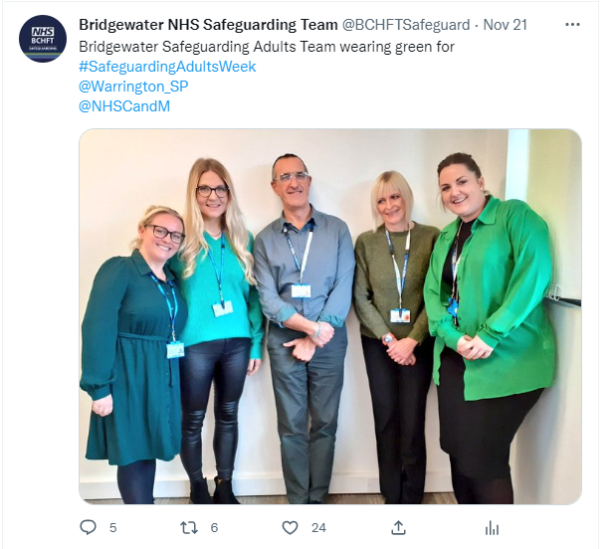
Partner Achievements 2022/23
Bridgewater Community Healthcare Foundation Trust continued:
Organisational Activity: Restorative Supervision It is recognised that the last few years have had a significant impact on all staff across the Trust and the need to care for our staff members emotional health and wellbeing has never been | more important: for the staff and for the direct correlation between staff wellbeing and patient care. Since the beginning of April 2022, all members of the Trust’s Safeguarding and CIC teams have had access to restorative supervision. Frequency of supervision is tailored to individual needs with all staff have restorative supervision a minimum of 3 monthly. This quote from a staff member is typical of the response to the programme: “I’m so pleased we have this (restorative supervision) in place as it really feels like we now have an opportunity to talk to (supervisor) who is so skilled and has such great listening skills – she actively listens to me. It’s also really important that (supervisor) is not my manager but has a good understanding of the service/the difficulties/the stresses that we are dealing with. I really feel that the time we have is for me – and (supervisor) emphasises this during the sessions. You never feel rushed. She also validates how you feel but also challenges in a very nurturing way. Overall it clears my head, means I have space to deal with complex situations on a daily basis, and feel more balanced, calm and valued”. Across the wider Trust, the introduction of Professional Nurse Advocate
Event | Example
The Team engaged with both Halton and Warrington Safeguarding Adults Boards in the promotion of Safeguarding Adults Week within the Trust Bulletin and on twitter. The Head of Safeguarding Adults contributed to the series of Lunch and Learn events organised by Halton Safeguarding Adults Board
26

Slide 27
Partner Achievements 2022/23
Bridgewater Community Healthcare Foundation Trust continued:
roles is enabling a similar restorative-focused opportunities to be brought to other clinical staff. Learning Disabilities The Safeguarding Adults Team are engaged with groups set up to improve the care of people with a learning disability: The Head of Safeguarding Adults represented the Trust at the multi-agency Learning Disability Standards Group The Head of Safeguarding and Safeguarding Specialist Nurse support the Trust’s Learning Disability Improvement Group. This is chaired by the Halton Borough Council Director and has dedicated specialist support of one day a week to the groups work plan from the Specialist Nurse Safeguarding Adults The Specialist Nurse has continued work to roll out Trust Best Practice Guidelines to clinical teams Mental Capacity Act Audit of MCA assessments was completed in Quarter 4 2021-22. Work related to this audit focused on identifying the key “relevant | Information” needed for common assessments including: Catheterisation Clexane administration Pressure Ulcer Prevention Pressure Ulcer Treatment Having Care Phlebotomy The Safeguarding Adult Team have worked with clinicians to draft learning resources based around key “relevant information” for specific decisions that are used in supervision with clinical teams.
27

Slide 28
Partner Achievements 2022/23
Healthwatch Halton
Quality Assurance: Healthwatch Halton has adopted the new Healthwatch England Quality Framework and introduced a new system for recording and monitoring the public feedback we receive on local health and care services. As part of this we have added additional safeguarding monitoring, with all public feedback being reviewed to highlight any safeguarding concerns. We continue to have representation at various stakeholder meetings which allows for regular sharing of information. Co-Production & Engagement: Our Advocacy Hub Team Lead attends monthly safeguarding meetings at Gateway Recovery Hospital with external parties such as the Safeguarding Team and the Police. From this we now receive updates from the Safeguarding Team to advise of safeguarding enquiries and this allows for any enquiries not received from the hospital. We also attend the Mental Health Law Governance Group from Merseycare and support the service with issues with the Brooker Centre. From this the Halton Advocacy Service are providing information to update the NICE guidelines for adults receiving advocacy support. | At public outreach sessions we continue to raise awareness of the role the public can play in safeguarding. Joint sessions have been held with Halton Carers Centre and Widnes & Runcorn Cancer Support. We work with local NHS Trusts to carry out “Listening Events” to gather the public views on services and highlight any issues, including safeguarding. We’ve held regular sessions with local veterans and local asylum support groups, we’ve also set up regular drop-in sessions for the local Traveller community. In November, we joined with partners to raise awareness of safeguarding during National Safeguarding Adults Awareness Week 2022. One of the main concerns raised with us this year was lack of access to NHS Dental Treatment. We’ve worked closely with NHS England to help a number of vulnerable local residents with severe oral health problems to access treatment at NHS dentists.
28

Slide 29
Partner Achievements 2022/23
Healthwatch Halton continued:
Learning & Professional Development: All Healthwatch Halton staff and board members undertake a wide range of online e-learning sessions in subjects such as Level 2 Adult and Child Safeguarding. In addition, our Advocacy Hub team are currently undertaking advocacy qualifications across different elements of the statutory services Healthwatch Halton provides. The aim is for all advocates to be qualified across all areas of the statutory services we provide. Training for all advocates has been through extensive online Flick training platform. Specialised training in Mental Capacity Law when undertaking S21A challenges to the Court of Protection has also taken place. Online training has been undertaken by all advocates provided by Blackbelt advocacy training services including relevant topics of statutory support including safeguarding, case law, supporting mental health in secure settings, when to support a S21A challenge. | Organisational Activity: During the past year Healthwatch Halton’s Advocacy Hub has supported more then 259 IMHA patients at the Gateway Recovery Centre and the Brooker Centre. The team support ongoing autistic and learning difficulty patients primarily each week and support extra meetings and assessments for these patients. The team responded to approximately 70 seclusion/safeguarding related issues across the statutory services. The main response for safeguarding is via Care Act referrals but we have also supported safeguarding concerns within the hospitals and work closely with the Safeguarding Team in ensuring standards at Gateway Recovery Centre and with Mersey Care NHS for the Brooker Centre. Our advocacy team have been instrumental in providing/promoting the IMHA advocacy service in two hospitals covering eight wards and units when receiving referrals from the hospitals but also provides extra support promoting further safeguards by visiting both hospitals each week, to allow self-referral of patients or to identify any patients not referred to the service.
29

Slide 30
Partner Achievements 2022/23
Healthwatch Halton continued:
The team have supported 86 IMCA referrals, primarily serious medical treatment decisions and this increased significantly throughout the Covid period. In addition our advocacy team have supported 31 DoLS referrals and continue to act as the Relevant Person’s Representative (RPR) for over 95 current cases.
30

Slide 31

Partner Achievements 2022/23
North West Ambulance Service
Background: The Trust has a statutory responsibility to safeguarding children and adults who are at risk of harm from abuse or those who are vulnerable, this commitment is underpinned by specific legislation, namely Children’s Act (1984 & 2004) and the Care Act (2014). The Trust works in partnership with other organisations to ensure that the response to individuals who are at risk of harm from abuse or neglect or who are vulnerable, is communicated in an effective manner which results in an appropriate response. Safeguarding child and adult standards are determined nationally for NHS Provider organisations and are monitored via the regulator (Care Quality Commission) and further through internal audits. Following a review of the safeguarding training and information shared with external agencies, a focused review and redesign was undertaken. In November 2022, the referral system for safeguarding referrals changed from ERISS system onto a new referral system through CLERIC. This system now allows staff to determine whether referrals are “safeguarding or early help”. As seen in the figures, this move has caused a significant drop in the number of referrals being made – this is attributed to a number of different factors, namely that crews can | make an improved, informed judgement on the type of help they believe is needed and due to the formation of other pathways now in place such as mental health. The new system has also had fewer rejections by social care than the ERISS system, which suggests that the new referral process is more accurate. Staff have also received additional training, prior to the move to CLERIC. Paramedic Emergency Services and the NWAS 111 service continue to be the two service areas which raise the most concerns. 31, 753 adult concerns were raised up to Mid-November 2022. From November to end of March 2023 there were 2,083 adult safeguarding concerns and 8,391 early help concerns raised – a significant decrease from the first 7 and a half months and approximately 18,000 less than 2021/22. The number of concerns raised for both adult and child has dropped dramatically. The new system also has the ability to split safeguarding referrals into “true” safeguarding where there is the element of actual or potential harm, or “early help” where social care needs have been identified and require additional support for example. There is also now greater understanding around mental health and the ability to
31

Slide 32
Partner Achievements 2022/23
North West Ambulance Service continued:
refer on the mental health pathways which is also partly attributing to the change in the numbers. Safeguarding Audits The safeguarding team currently carry our two audit cycles a year. These are deep dive audits that focus currently on repeat children’s safeguarding concerns and domestic abuse. The domestic abuse audit is carried out to ensure that there have been no missed opportunities to raise concerns for the person at risk. It is to provide assurance that staff are reporting appropriately through onward communication with social care, the police or specialist domestic abuse advisor and that when domestic abuse is witnessed or disclosed, then a safeguarding concern has been raised. It also provides the team with the opportunity to review more in depth cases and to educate staff where needed. These audits also provide assurance that where cases of domestic violence are raised, safeguarding concerns for any children in the family are also raised jointly. Both audits require the analysis of data and the contacting of the | relevant multi-agency partners which for these specific audits would usually be social care and the police. Polices and Procedures During 2022/23 the following procedures have been reviewed and updated: Managing Allegations against staff policy Domestic Abuse procedures Missing & Absconding patients’ procedure Ongoing awareness updates and 7 minute briefings have also been published regularly as part of the continuing safeguarding education through the Communications team. Safeguarding Assurance Framework The Safeguarding Assurance Framework (SAF) is an assurance document which the Trust are required to complete and return to the Lead Commissioners. The SAF asks specific questions of the safeguarding arrangements which are in place within the Trust. The document once agreed is shared with the 46 safeguarding boards. The safeguarding boards use the NWAS response to form part of their
32

Slide 33
Partner Achievements 2022/23
North West Ambulance Service continued:
overall multi-agency section 11 report. The 2022/23 assurance framework report is still in draft and has not as yet been verified through the commissioners, however, high compliance and assurance is evidenced throughout the report. This is currently being discussed with the lead ICB and expected to be shared June 2023. There are areas which continue to be focal points for action within the Safeguarding Team and the wider Trust. There remain two points in the standards which the Trust is unable to mark themselves as fully compliant. One of these being the Trust delivering stand-alone domestic abuse training. At present this training is delivered on an ongoing basis as part of the mandatory training and safeguarding level 3 training packages. A stand-alone option is being considered and a package will be developed in due course. This will be part of the 2023/24 training plan. In regard to the second non-compliant standard, this is in relation to staff appraisals and the inclusion of safeguarding being part of the appraisal process. The Trust do not currently feature safeguarding as a specific item within each member of staff’s individual appraisal. The need for specific safeguarding questions within individual appraisals will | be reviewed and considered with HR. Safeguarding Assurance Each month the Trust receives a number of case requests from adult or children’s social care or multi-agency safeguarding boards, where we are asked to provide information on our Trust’s involvement. These can take several forms from a simple enquiry, a rapid review, chronology or completion of a individual management review. There have been 254 case reviews requested this year for 2022/23. Some of these cases were reviewed and described showing good practice, potential missed opportunities, multi-agency working and actions. Outcomes and learning from these reviews were listed alongside highlighted areas of good practice, challenges and suggested next steps. Whilst there will occasionally be missed opportunities to make safeguarding notifications these are improving. This is due to various actions being put in place, including sharing of bulletins, 7 minute briefings, updating of training and highlighting lessons learnt through committees. The move from ERISS to CLERIC has also reduced the number of rejections of cases, received back into the Trust from social care. This is due to the fact that we now have more appropriate
33

Slide 34

Partner Achievements 2022/23
North West Ambulance Service continued:
referral pathways in place including early help and mental health, which then allows only “true” safeguarding referrals to be accepted. This results in patients receiving the care and support they require in a timelier way. Safeguarding Board Engagement Increased notifications, improved visibility and Board engagement has resulted in increased numbers of requests to be involved in Safeguarding Adult Reviews, Domestic Homicide Reviews, Serious Case Reviews, Learning Disability Reviews and Strategy Meetings. The Safeguarding Team work alongside senior managers and clinicians to ensure engagement with the Boards is visible and specific to local needs. There are currently 46 safeguarding board across the geographical footprint of North West Ambulance Service and the team have committed to attend each board a minimum of once per year, as per local board request as deemed appropriate. The Safeguarding Team monitor Board engagement. Each local Safeguarding Board is formally written to on an annual basis by the Safeguarding Manager, to inform them of our commitment to | engage with the Safeguarding Boards and to establish good working relationships in each area. A copy of the Trust’s annual safeguarding report is also shared, this prompts invites to Board meetings to discuss the safeguarding activity within the Trust and look at ways of collaboratively working to improve safeguarding partnerships. In addition, practitioners and managers are involved in Local Safeguarding Board sub groups.
34

Slide 35
Policy, Practice & Procedure Sub Group
Update
Chair: Marie Lynch – Operational Director, Care Management, Safeguarding & Quality, Halton Borough Council
June/July 2022 – Pop up scam events held at Runcorn Shopping City and Widnes Market during the summer 2022
July 2022 – New Safeguarding Induction Booklet was developed and published on the HSAB website
September 2022 – HSAB Annual Report for 2021/22 was completed and shared with partners including the Halton Health & Wellbeing Board
December 2022 – Annual Strategic Planning event held for HSAB where priorities were reviewed
March 2023 – Modern Slavery Toolkit has been developed and added to the HSAB website
March 2023 – Financial Abuse Toolkit has been developed and added to the HSAB website
March 2023 – A review of the Multi-Agency Public Protection Arrangements (MAPPA) Policy was conducted and the policy was updated and distributed. Further work planned in respect to associated training with regards to MAPPA
Ongoing activity from 2022/23 into 2023/24:
Framework drafted in respect to Harmful Sexual Behaviours with Adults with Learning Disabilities/Autism – work to continue to be taken forward during 2023/24 via a Task and Finish Group
Safeguarding Adults Policy, Procedure and Guidance – work is continuing on the review of the current guidance and will be completed during 2023
Multi-Agency Risk Assessment and Management (MARAM) policy – work progressing on the development of this policy and will be completed during 2023

Slide 36
Safeguarding Adult Review Sub
Group Update
Chair: Helen Moir - Divisional Manager Independent Living, Halton Borough Council
The Safeguarding Adult Review (SAR) Sub Group initially sat within the HSAB Practice Sub Group until the restructure of sub groups in November 2022
May 2022 – members for the Mervyn Task and Finish Group were identified
July 2022 – the first Mervyn Task and Finish Group meeting took place. The Terms of Reference were drafted and the purpose was to focus on the recommendations and map what they mean for Halton. Once this happened, it was brought back to the group for recommendations
August 2022 – the Mervyn Task and Finish Group recommendations were updated
February 2022 – The Group is looking at the update from the Task and Finish Group re: Mervyn SAR and there will be a similar action log for Whorlton Hall SAR
February 2022 – the group has started looking at reviewing the current SAR policy

Slide 37
Performance, Quality Assurance &
Audit Sub Group Update
Chair: Danielle Knox - Detective Chief Inspector, Cheshire Constabulary
The Performance, Quality Assurance and Audit Sub Group tasks initially sat within the HSAB Practice Sub Group until the restructure of the sub groups in November 2022.
April 2022 – the HSAB Dashboard was created with the first populated HSAB dashboard being presented at Executive Group and HSAB from July 2022 on a quarterly basis
April 2022 – work had started on developing Multi-Agency audits
September 2022 – the first Multi-Agency Audits took place and the theme was Financial Abuse
February 2023 – it was agreed for the standard training items
and the self-neglect training to be progressed for the 2023/24 HSAB training programme
February 2023 – The Performance, Quality Assurance and Audits Sub Group moving forwards will be used to look at themes and trends for Multi-Agency Audits
March 2023 – the HSAB training programme was shared and uploaded onto the HSAB website

Slide 38
Partnership Forum Update
Chair: Mark Weights – CEO, Sustainable Housing Action Partnership
September 2022 – Partnership Newsletter created and dates agreed for distribution to partners. First newsletter distributed in September 2022
October 2022 – Presentations from specific partners introduced to each Partnership Forum meeting
October 2022 – Presentation relating to Domestic Violence and Older People. Task and Finish Group set up to look at issues raised in presentation
December 2022 – Safeguarding Adults Survey completed with an analysis, outcomes and recommendations provided to HSAB. Partnership Forum requested marketing budget from HSAB to implement outcomes from survey
January 2023 – Communications and Engagement Strategy – distribution of national and local events plan updated for 2023
March 2023 – Domestic Violence and Older People Task and Finish Group created a new Domestic Violence Toolkit for providers, including a dementia checklist for use within Halton
March 2023 – Partnership Forum commenced work on engagement with service users and people with lived experience to support future safeguarding processes and safeguarding multi-agency audits
March 2023 – second Partnership Forum Newsletter distributed to partners
March 2023 – Forum agreed Safeguarding Adults Strategy for 2023-2028

Slide 39
HSAB Strategic Planning Event
HSAB held a virtual Strategic Planning Event on Thursday 1st December 2022 via MS Teams, to develop priorities and key actions to inform the “Strategic Plan on a Page” and work programmes of the HSAB and its associated sub groups. The event was well attended with 32 representatives from all statutory partners, health sector and voluntary/third sector organisations as detailed below:
The event was facilitated by Moira Wilson, Care and Health Improvement Advisor, Yorkshire and Humber for the Local Government Association. The event began with an introduction and outline of the event that Moira presented, reminding partners of the legal context from the Care Act 2014, along with some current issues and priorities and the outcomes from the day. Helen Moir, Divisional Manager for Independent Living and Safeguarding Lead at Halton Borough Council, gave a presentation on the pre-work themes and what the data is telling us.
This led to five breakout room discussions focused on the draft Strategic Plan; what other work areas should be added to the draft plan; what actions can organisations take to progress the proposed work areas and what support or guidance might sub groups provide to support member organisations. Each group had a one-hour discussion and then fed back to the whole group.
Next Steps
The Annual Report was shared with the Health Policy and Performance Board in September.

Slide 40

HSAB Strategic Planning Event
Information gathered from the Strategic Planning Event is being used by HSAB sub group Chairpersons to support the development of the work programmes for the sub groups into 2023/24 and beyond. Progress with the work programmes will be monitored through the HSAB Executive Group, who will update the HSAB as appropriate.
The Strategic Planning Event is recognised as an important way of engaging with partners in identifying priority areas for the HSAB and its sub groups to keep people safe and as such will be an annual event.

Slide 41



National Safeguarding Week
HSAB supports the National Safeguarding Adults Week on an annual basis, it took place this year during 21st – 27th November 2022. The campaign came about through a national collaboration with Ann Craft Trust and the Safeguarding Adults Board Managers Network, supported by University of Nottingham. Locally, HSAB collaborated with the following statutory, private and voluntary services to help raise awareness of National Safeguarding Week across Halton:
The aim of the campaign this year was “Responding to Contemporary Safeguarding Challenges”. Each day during National Safeguarding Week focuses on a key theme, the daily themes for this year were as follows
Day | Theme
Monday | Exploitation & County Lines
Tuesday | Self-Neglect
Wednesday | Creating Safer Organisational Cultures
Thursday | Elder Abuse
Friday | Domestic Abuse in Tech-Society
Saturday & Sunday | Safeguarding in every day life

Slide 42
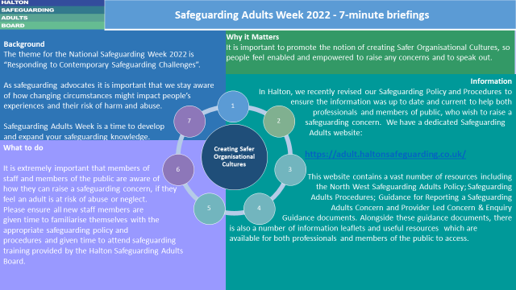
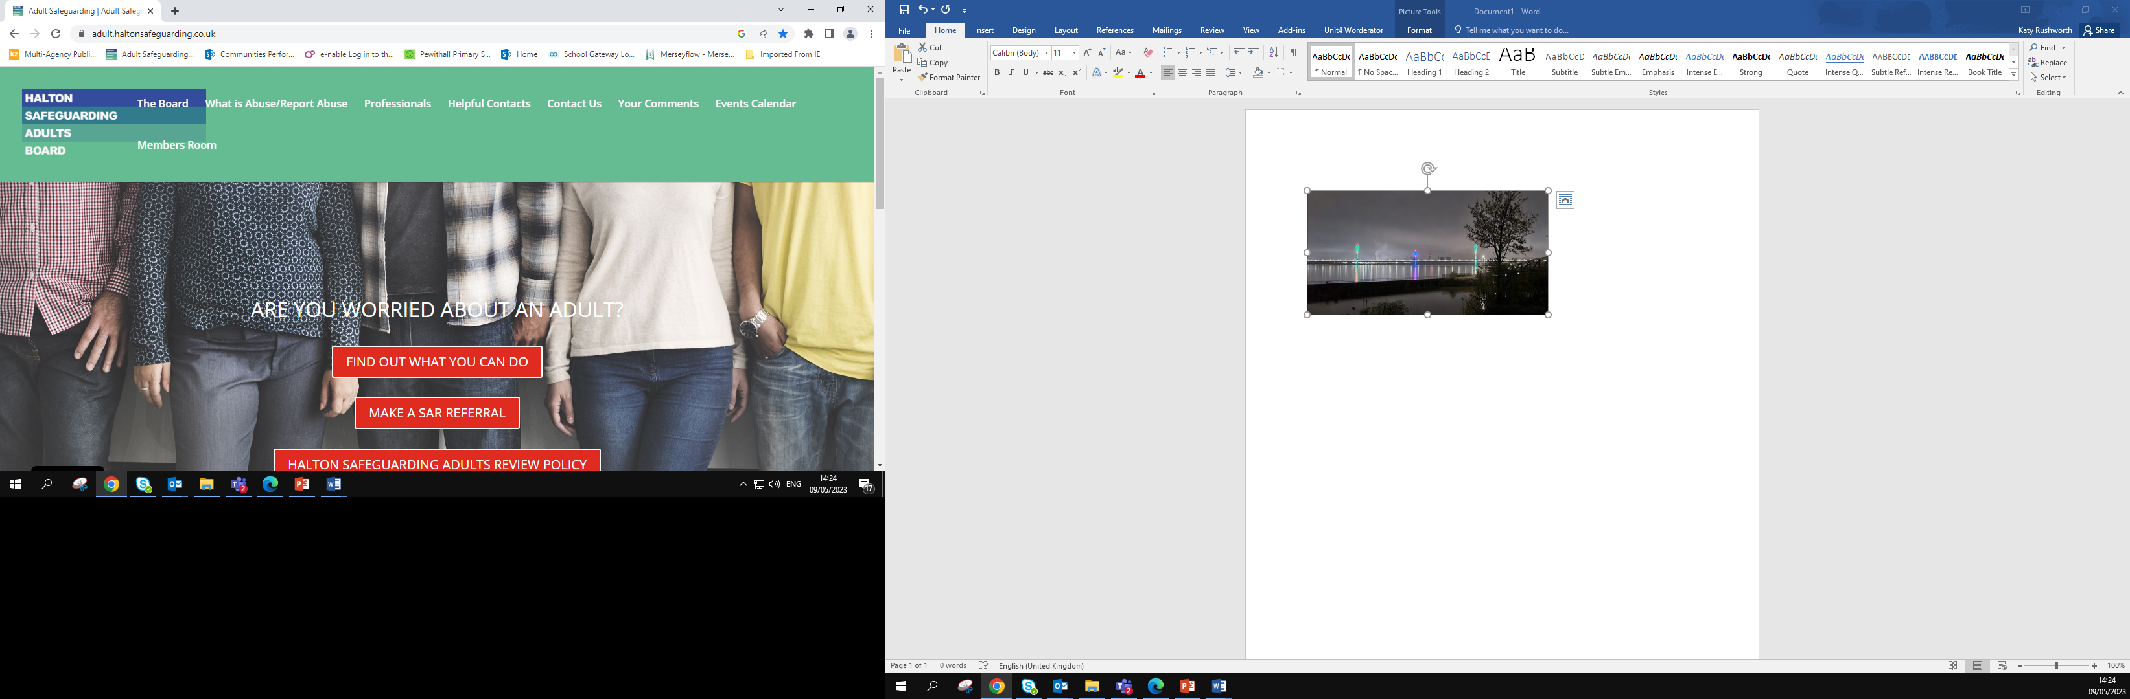



National Safeguarding Week
The campaign consisted of:
A 7 minute briefing for each daily theme cascaded to all HSAB partners to distribute
Within their own organisations
HSAB Website fully updated and has a dedicated National Safeguarding Week tab with all information easily accessible
A series of Lunch & Learn events were held online for
each of the daily themes for all HSAB Partner organisations to
attend
Mersey Gateway Bridge lit up in
HSAB colours to mark the start of
National Safeguarding Week
Daily social media messages published
on all HBC Social Media Platforms

Slide 43
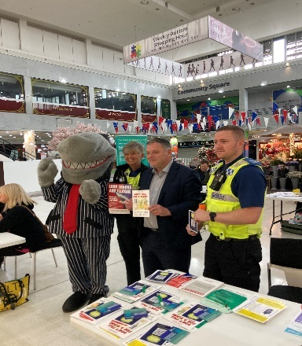
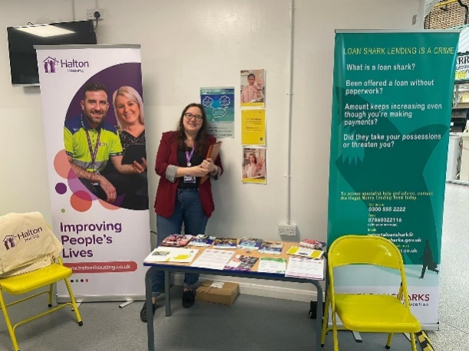


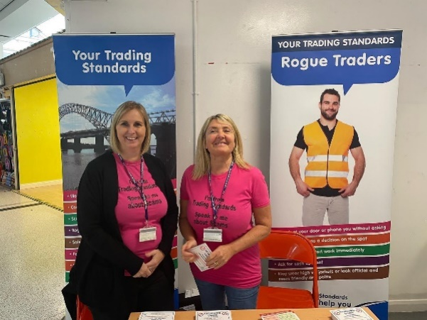
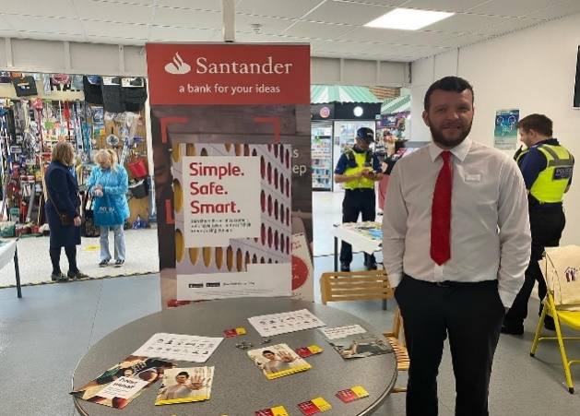
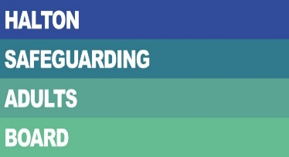

Scam Awareness Events
Two pop up awareness raising events were held in the summer on behalf of HSAB. The theme of the events was scam awareness, as during the pandemic we saw an increase in the number of scams targeting vulnerable members of the borough.
The first event was held at Widnes Market on 29th June 2022 and the second event was held at Runcorn Shopping City on 7th July 2022. The event was supported by MP Mike Amesbury and representatives from the following organisations:
The events provided an opportunity for members of the public to talk to staff members from the organisations present to find out more information about how they could keep themselves safe from possible financial abuse and learn more about how to protect themselves from falling victim to scams in the future.

Slide 44

Multi-Agency Audits
HSAB implemented a new Safeguarding Case File Audit Policy in July 2022. The aim of the policy was to provide a robust audit process which is central to HSAB quality assurance system and offers front line staff an opportunity to reflect in a safe environment.
The safeguarding adults audits are centred on analysing quality with a view to gauging how effective our safeguarding practice is, in improving outcomes for the service user. The process is focused on learning and any recommendations are monitored. The process does not focus on the individual practitioners (although feedback will be given), but assists senior and service managers by providing evidence of recurring key issues/patterns or trends in safeguarding practice across adult services, as a means of informing future improvement and development.
The first round of multi-agency audits took place in September 2022 with the theme of Financial Abuse. Three cases were selected and as a result of this audit, our Financial Abuse Toolkit was reviewed and updated.
The second round of multi-agency audits took place in April 2023 (delayed from January 2023 due to winter pressures on services). The theme for the second audit was self-neglect. Again as a result of this audit, the Self-Neglect Policy and Toolkit will be reviewed during 2023-24 to ensure information is relevant and current for practitioners to utilise.

Slide 45
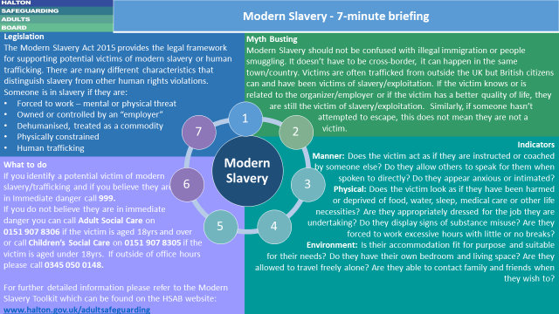
Modern Slavery Toolkit
Building on the Modern Slavery Strategy Cheshire, the Modern Slavery Toolkit was devised to help practitioners with cases of modern slavery and where to find accessible resources available to them.
This toolkit was based upon the Pan Lancashire Anti-Slavery Partnership Modern Slavery Toolkit, with permission.
The toolkit provides an overview of what modern slavery is, provides details of the referral pathway for victims of modern slavery and human trafficking, how to identify possible victims of modern slavery and key legislation and resources which may help practitioners when dealing with a case of modern slavery and human trafficking.
The toolkit was approved by HSAB and was distributed to staff members, HSAB partners and is available to view via the HSAB website:
www.halton.gov.uk/adultsafeguarding
A 7 minute briefing was also developed for staff members and partner agencies for ease of reference.

Slide 46

Financial Abuse Toolkit
The Financial Abuse Toolkit in Halton was originally produced in 2015 and following our first Multi-Agency Safeguarding audit focused on financial abuse held in September 2022, the toolkit has now been reviewed and updated.
The Financial Abuse Toolkit is intended to be used by Adult Social Care staff, partner agencies, providers and members of the public. It will provide them with the information they need to respond appropriately to suspected cases of financial abuse.
It is important that the indicators of financial abuse are recognized, so that safeguarding concerns can be raised appropriately.
The Financial Abuse Toolkit will:
Provide advice on when to raise a safeguarding concern
Provide information on the indicators of financial abuse and who is vulnerable to financial abuse
Provide a range of preventative measures
Emphasise the importance of partnership working
Provide case examples that demonstrate how financial abuse enquiries can be conducted effectively
Provide information in additional resources for further reading and sharing with adults who may be vulnerable to financial abuse and partner agencies

Slide 47
Case Study
Initial concern received to Local Authority:
Concern raised by local housing provider in relation to possible financial exploitation of a number of elderly residents by a neighbour in a particular area of the borough. The neighbour had offered to complete caring tasks for the residents and in turn was borrowing money from the residents who, due to the tasks the neighbour was completing, felt obligated to agree to.
In addition to this, the neighbour was often completing shopping tasks and taking more money than what was required and not providing any change.
Further discussions with the housing officer revealed that the individual in question, had previously been known to both police and the housing association for fraudulent activity of the same nature in recent years.
Intervention and Planning:
Prior to any interventions with the named vulnerable adults, a multi-agency professionals meeting was held in order to share information and to formulate a strategy in order to safeguard the residents. Intelligence from both police and housing officers revealed that there was possibly more victims than initially thought and more than one perpetrator, who both lived separately in the same neighbourhood. Housing officers
informed that it was very difficult to speak to any of the potential victims alone, as the alleged perpetrators would alert each other when any professionals would call at the homes of the victims and either of the alleged perpetrators would “just pop in” to see if the victim needed anything, playing the role of a caring neighbour.
Many of the residents were socially isolated and had become reliant on the tasks that the perpetrators completed and were reluctant to make a complaint, therefore, the concerns raised needed to be approached sensitively, ensuring that the views of the victims were taken into consideration and that reassurance was given.
The decision was taken between partner agencies that an open day with the locality was the best option to invite a number of agencies to include debt management; trading standards (around fraud); police; social services; housing association and a number of other agencies in order to residents to explore what services could offer and allow for the safeguarding team to speak with a number of residents of whom there were concerns. This meant not singling any particular residents out and not making any accusations. The social worker and housing officer took goodie bags with information leaflets and other items, to those residents who could not attend allowing for a foot in the door approach and an opportunity to open

Slide 48
Case Study
conversation around financial exploitation.
During these initial enquiries, the professionals were approached by the alleged perpetrators who informed them that it was a close knit community, where everyone looks out for each other and people did not need any support from services.
Outcomes Achieved:
As a consequence of the open day, a number of adults at risk were identified and offered social care support. It was made clear to them that any tasks that they may need help with, could be facilitated by the local authority which would be a formal arrangement with no unexpected costs.
The joint approach by partner agencies that some adults at risk were safeguarded by various methods, such as support with shopping; accessing the community; assistance with personal care and assistance with managing finances and bills.
It was evidenced that as a result of this multi-agency intervention, the perpetrators reduced their contact with some of the residents as their method of offering to complete tasks was no longer required and professionals having regular
contact were able to monitor the situation.
Work continues with the housing association, police and safeguarding team with planned annual community outreach events, to target vulnerable individuals living in this locality as a result of the positive outcomes of the initial piece of work with all agencies involved sharing intelligence as a preventative measure.
Benefits of the work:
Multi-Agency work allowing for information sharing
Positive professional relationships allowing for improved collaboration between agencies
Residents who may not have previously become known to adult social care were offered assessments
Raised awareness of financial exploitation between residents of the area and how to seek help and support
Annual events to monitor outcomes and reinforce initial work
Person-Centred approach taking into consideration the wishes and feelings of the residents

