Slide 1
Modern Slavery Awareness session Tricia Mullen Designated Nurse Safeguarding Adults

Slide 2
Aim of the Session:
To gain (or refresh) understanding of what Modern Slavery is.
Types of Modern Slavery.
Signs and Indicators
Local and National Picture
What to do if you have a concern.

Slide 3
What is Modern Slavery ?
It is an umbrella term for all forms of slavery. Human trafficking, and exploitation.
It is the recruitment, movement, harbouring or receiving of individuals for exploitation. It includes holding a person in a position of slavery, servitude, or facilitating their travel with the intention of exploiting them. Forced labour is a type of modern slavery where victims are forced to work long hours for little or no pay in poor conditions under verbal or physical threats of violence to them or their families.
It can happen in various industries.

Slide 4
Types of MS/ Exploitation
Sexual Exploitation (mainly Women or Children)
Forced Labour (many sectors)
Domestic Servitude
Criminal Exploitation (country lines/ Cuckooing/ organised theft/ force begging)
Organ Harvesting

Slide 5
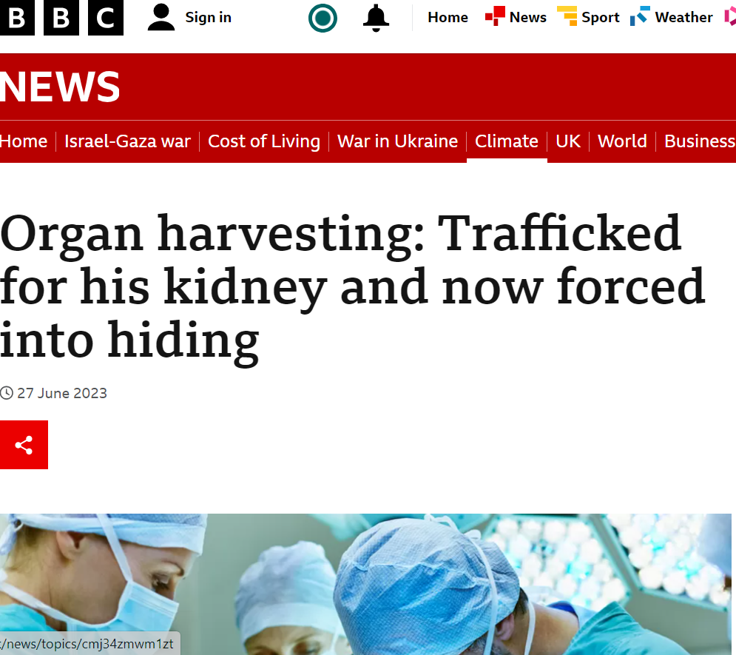

Slide 6
Signs and Indicators
Appearance
Isolation
Poor living conditions
Few or no personal effects
Unusual travel times

Slide 7
National / Local activity
Huge increase in referrals nationally in 2023.
UK Nationals most common nationality referred in (25%).
24% of all referrals were females.
Children made up more than 4 in 10 referrals (↑ on record).

Slide 8
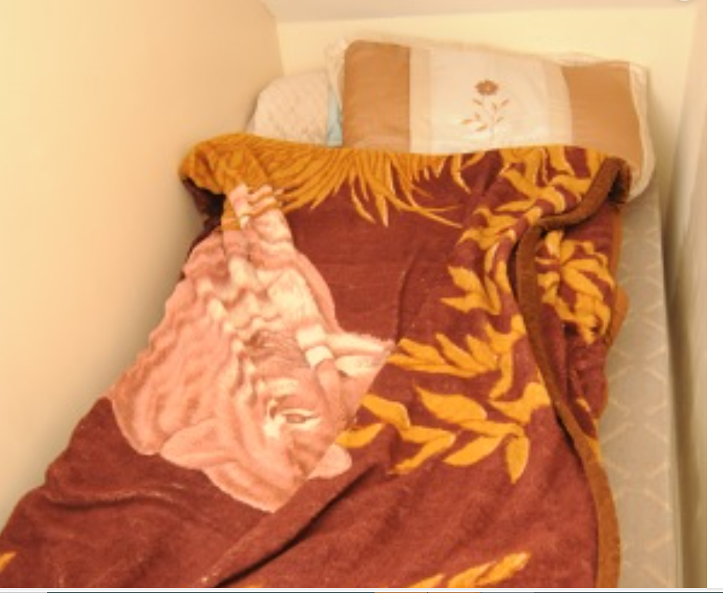
Local Activity

Slide 9
What should I do?
Keep an open mind.
If something seems unusual, share your concerns with your manager/ colleague.
Collectively discuss and decide next steps.

Slide 10
Refer on
Urgent, you feel there is an immediate threat to the person. Call Police 999.
If the person is under 18yrs make a Child Safeguarding Referral to HBC via ICART 01519078305.
If the person has care and support needs. And you feel they are at risk of abuse or neglect, and they cannot protect themselves make a Safeguarding Adult referral to HBC 01519078306
If the adult does not have care needs, call the Modern-Day Slavery Helpline 08000121700

Slide 11
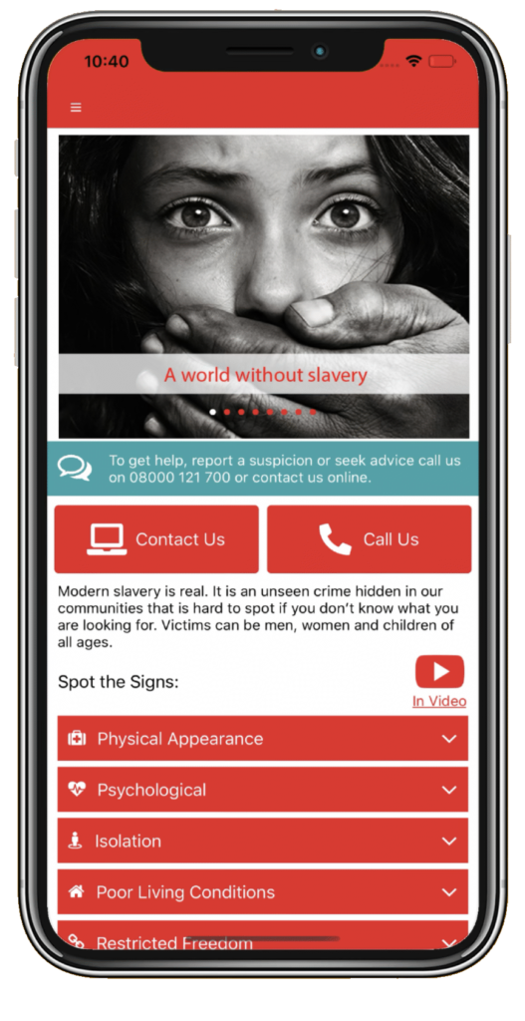
UNSEEN APP

Slide 12
Recap
Looked at what Modern Slavery is?
The various types of Modern Slavery
The signs and indicators
The local activity level and view
What you should do if you have a concern
Referral pathways

Slide 13
Thank you for listening
Any Questions?

